Slide 1
JEEVAK AYURVEDIC MEDICAL COLLEGE
KAMLAPUR AKAUNI CHANDAULI
TOPIC :- Concept of Shira and
Vascular System of Body
Guided By:-
Dr.Sanjay Singh Chauhan
Dr.Anamika Kumari
Presented By:-
Ritesh Tiwari
Ruhul Islam

Slide 2
VASCULAR SYSTEM OF BODY

Slide 3
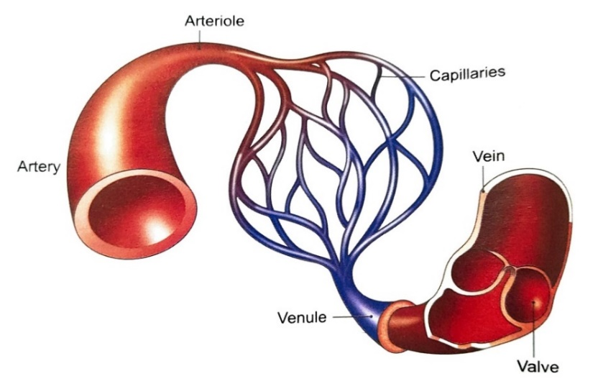
VASCULAR SYSTEM OF BODY
The vascular system, also called the circulatory system, is made up of vessels that carry blood, and lymph through the body. The arteries and veins carry blood throught the body, delivering oxygen and nutrients to the body tissues and taking away tissue waste matter.
There are 5 classes of blood vessels :
Arteries and Arterioles
Veins and Venules
Capillaries (the smallest blood vessels, linking arterioles and venules through networks within organs to tissues).

Slide 4
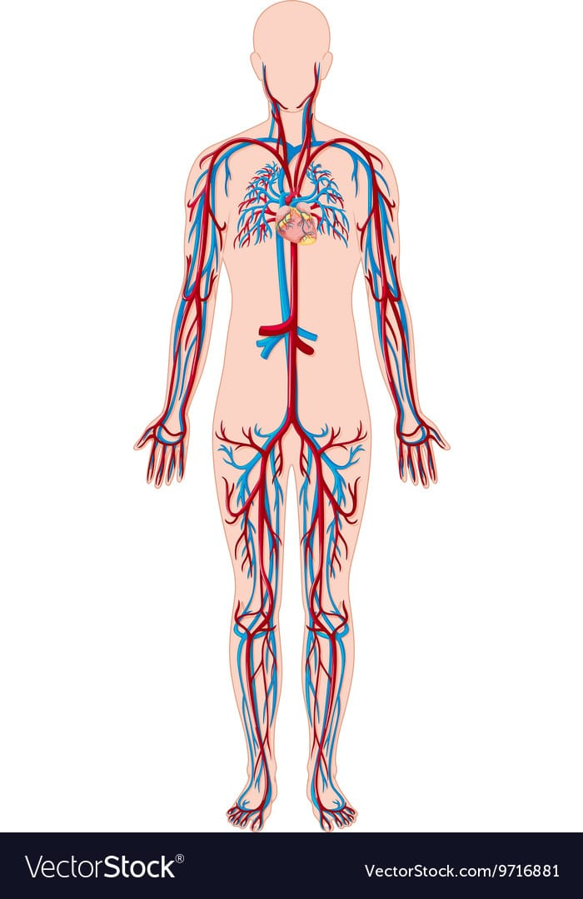
BLOOD VESSELS
Blood vessels form the transport system of the body, through which the nutrients are conveyed to places where these are utilized and the metabolites (waste products) are conveyed to appropriate places from where these are expelled.
The conveying medium is liquid tissue, the blood, which flows in tubular channels called blood vessels. The circulation is maintained by the central pumping organ called the heart.

Slide 5
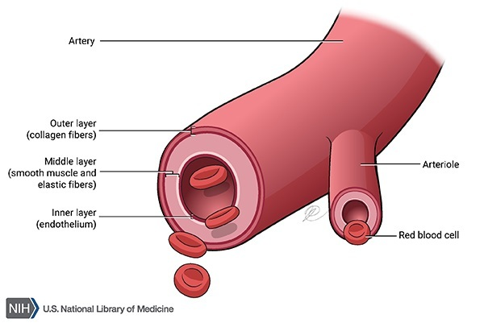
ARTERIES
These are distributing channels which carry blood away from the heart. Aorta is the largest arteries.
These branch like trees on their way to different parts of the body. These contain oxygenated blood except pulmonary trunk and its two branches.
The pulmonary arteries, which carry deoxygenated blood, During fetal life the umbilical arteries contain deoxygenated blood.
The large arteries are rich in elastic tissue, but as branching progresses there is an ever increasing amount of smooth muscle in their walls.
The minute branches which are just visible to naked eyes are called arterioles. These give maximum peripheral resistance.

Slide 6
VEINS
These are draining channels which carry deoxygenated blood from different parts of the body back to the heart.
Like rivers, the veins are formed by tributaries.
The small veins (venules) join together to form large veins. These in turn unite to form great vein called venae cavae. Inferior vana cava is the largest vein. The four pulmonary veins carry oxygenated blood.
In fetal life the umbilical veins carry oxygenated blood.

Slide 7
CAPILLARIES
These are network of microscopic vessels which connects arterioles with the venules.
These come in intimate contact with the tissues for a free exchange of nutrients and metabolites across their walls between the blood and the tissue fluid.
The metabolites are partly drained by the capillaries and partly by lymphatics
Capillaries are replaced by sinusoids in certain organs like liver and spleen.

Slide 8
BLOOD VESSELS CAN CLASSIFIED INT0:
Distributing vessels, including arteries.
Resistance vessels, including arterioles and precapillary sphincter.
Exchange vessels, including capillaries, sinusoids, and post capillary venules.
Reservoir (capacitance) vessels, including larger venules and veins.
Shunts, including various types of anastomes.

Slide 9
TYPES OF CIRCULATION OF BLOOD
Total amount of blood in adult is 4.5 – 5 liters.
There are two types of blood circulation:
Systematic (greater) circulation
Pulmonary Circulation

Slide 10
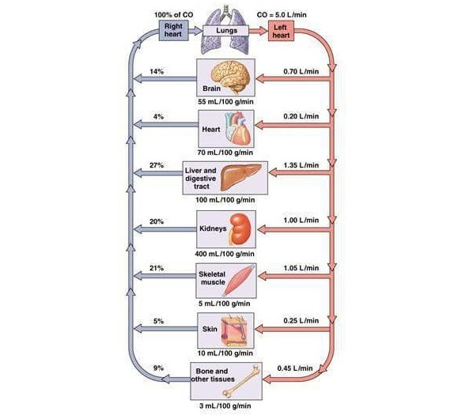
Distribution of Blood in the Body at Rest

Slide 11
SYSTEMATIC (GREATER) CIRCULATION:
Left Ventricle
Right atrium
Aortic valve
Superior vena cava and
Aorta inferior vana cava
Oxygenated blood to all Venous blood collected
tissues except lungs.

Slide 12
PULMONARY CIRCULATION
Right ventricle
Pulmonary valve
Left atrium
Pulmonary trunk and
Pulmonary artery 4 Pulmonary veins
Only to lungs Deoxygenated blood gets oxygenated

Slide 13
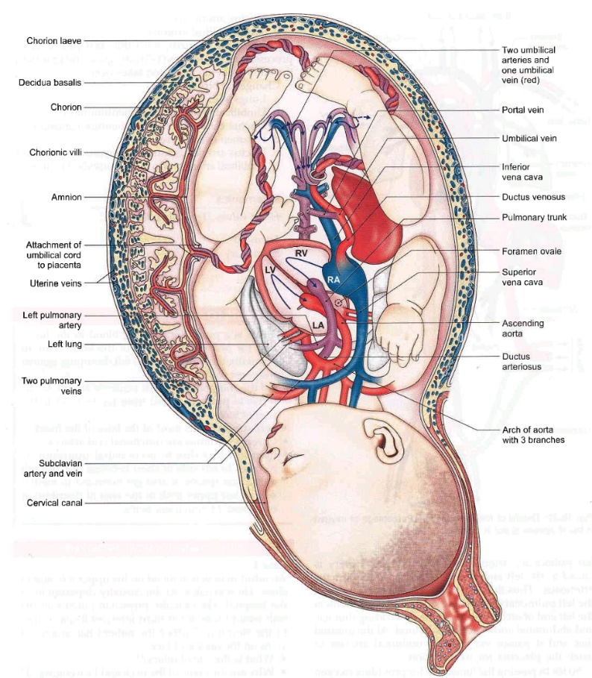
FEOTAL CIRCULATION

Slide 14
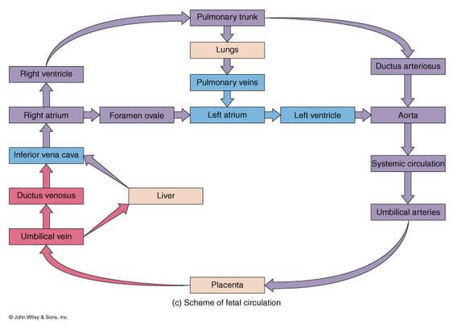
Fetal circulation

Slide 15
ARTERIES

Slide 16
ARTERIES
Arteries are thick walled, being uniformly thicker than the accompanying veins, except for the arteries within the cranium and vertebral canal where these are thin.
Their lumen is smaller than that of accompanying vein.
Arteries have no valves.
An artery is usually accompanied by vein(s), nerve(s), and lymphatics and the all of them together form the neurovascular bundle which is surrounded by fibro areolar sheath.

Slide 17
TYPES OF ARTERIES AND STRUCTURE
Large arteries of elastic type, E.g Aorta and its main branches (brachiocephalic, common carotid, subclavian, common iliac and pulmonary trunk).
Medium and small arteries of muscular type, E.g ulnar, radial, femoral and popliteal, etc.
Smallest arteries of muscular type are called arterioles. They measure 50 – 60 micron in diameter.
It is important to know that the muscular arterioles are responsible for generating the diastolic blood pressure.

Slide 18
BLOOD SUPPLY OF ARTERIES
The large arteries of more than 1 mm diameter are supplied with blood vessels.
The nutrient vessels, called vasa vasorum, form a dense capillary network in the tunica adventitia, and supply the adventitia and outer part in tunica media.
The rest of the vessel wall (intima + inner part of media) is nourished directly by diffusion from the luminal blood.
Minute veins accompanying the arteries drain the blood from the outer part of arterial wall.
Lymphatics are also present in the adventitia.

Slide 19
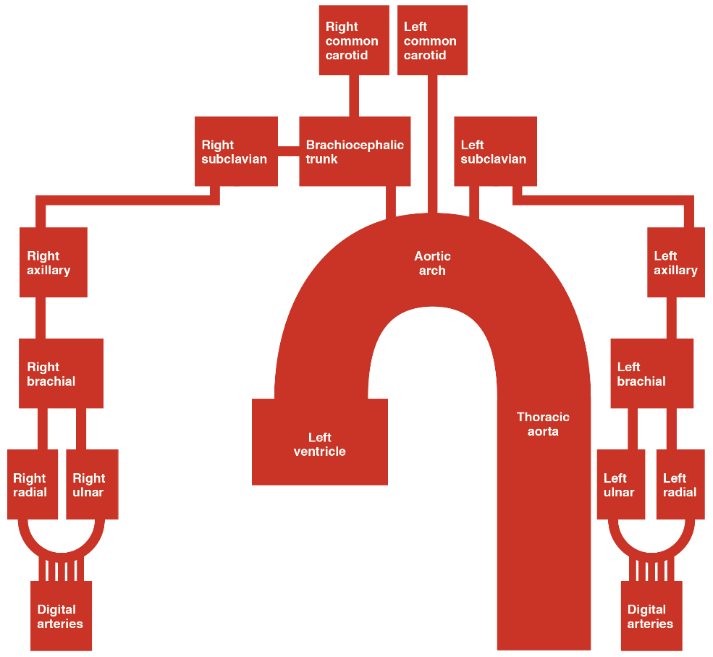
ARTERIAL SUPPLY TO THE UPPER LIMBS

Slide 20
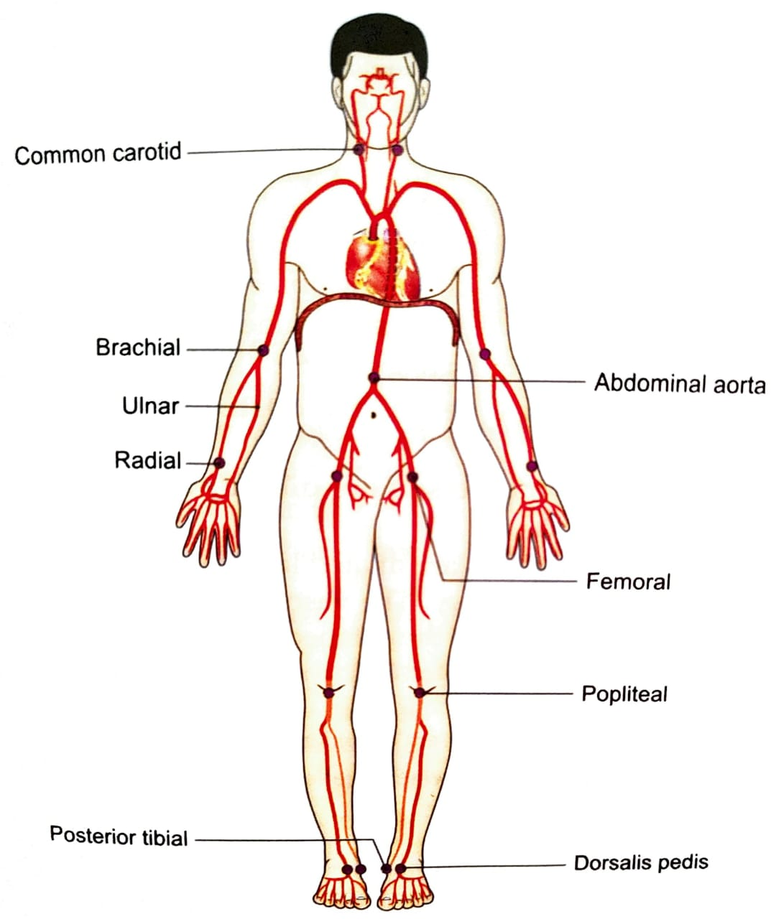
PALPABLE ARTERIES
Some arteries can be palpated through the skin.
These are:
Common carotid,
Facial,
brachial,
Abdominal aorta,
Femoral,
Posterior tibial and
Dorsalis pedis.
The most commonly felt pulse is the radial pulse on the anterolateral aspect of wrist. Carotid pulse next to trachea is also easily felt.

Slide 21
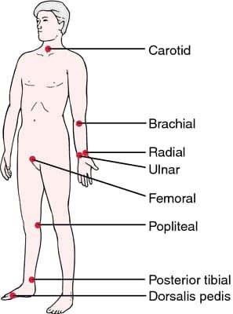

Slide 22
NERVE SUPPLY OF ARTERIES
The nerve supplying an artery are called nervi vascularis.
The nerves are mostly thinly myelinated sympathetic fibres which are vasoconstrictor in function. A few fibres are myelinated, and are believed to be sensory to the outer and inner coats of the arteries.
Vasodilator innervation is restricted to the following sites.
The skeletal muscle vessels are dilated by cholinergic sympathetic nerves.
The exocrine gland vessels are dilated on parasympathetic stimulation.
The cutaneous vessels are dilated locally to produce the flare (redness) after an injury. The vasodilation is used produced by the afferent impulses in the cutaneous nerves which pass antidromically in their collaterals to the blood vessels (axon reflex)

Slide 23
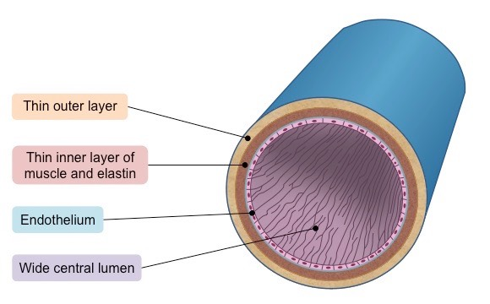
VEINS

Slide 24
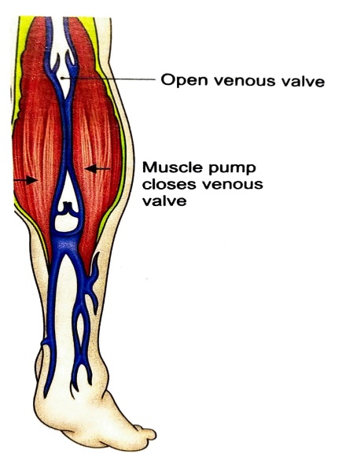
VEINS
CHARACTERISTIC FEATURES
Veins are thin walled, being thinner than the arteries.
There lumen is larger than that of the accompanying arteries.
Veins have valves which maintain the unidirectional flow of blood even against the gravity.
Since the venous pressure is low (7mm Hg), the valves are the utmost value in the venous return. However, the valves are absent:
Venous valves for unidirectional flow of venous blood

Slide 25
In the veins of less than 2mm diameter.
In the venae cavae
In the hepatic, renal, uterine, ovarian (not testicular), cerebral, spinal, pulmonary, and the umbilical veins
The muscular and elastic tissue content of the venous walls is much less than that of the arteries. This is directly related to the low- venous pressure.
Large veins have dead space around them for their dilation during increased venous return, femoral canal medial to femoral vein. The dead space commonly contains the regional lymph nodes.
Venae comitantes are a pair of veins on each side of the artery in the forearm and leg region. These help in return of blood towards the heart by transmitted pulsation of the artery. The blood in artery and vein flow in opposite direction.

Slide 26
VENOUS SYSTEM
Caval system includes superior and inferiorcaval veins. Veins associated with the system are: Emissary veins of the cranial cavity, these connects intracranial and extracranial veins. These help to lower intracranial pressure in some situations. Also the infection from outside may reach the cranial cavity.
PORTAL SYSTEM: It is made up of two sets of capillaries, E.g: hepatic portal:- Capillaries join to form veins which form portal veins. It divides into branches which form veins/sinusoids.
HYPOPHYSEAL PORTAL SYSTEM: Seen in anterior pituitary gland is an example of this system, the other example is portal vein in gastrointestinal system.

Slide 27
STRUCTURE OF VEINS
Veins are usually made up of usual three coats which are found in the arteries. And the muscle and elastic tissue content is poor.
In poorly developed tunica media, the amount of collagen fibres is more than the elastic and muscle fibres. The adventitia is thickest and best developed. The smooth muscle is altogether absent:
In the veins of maternal part of placenta.
In the cranial venous sinuses and pial veins.
In the retinal veins
In the veins of cancellous bone.
In the venous spaces of the corpora cavernosa and the corpus spongiosum of penis.

Slide 28
TYPES OF VEINS
LAYERS | LARGE VEINS | MEDIUM SIZE VEINS | VENULES
Tunica Intima | Endothelium, basal lamina, sub endothilial tissue, valves may be seen. | Same as In large vein | Endothelium, basal lamina and pericytes
Tunica Media | Smooth muscle and connective tissue | Smooth muscle and connective tissue | Few smooth muscles and loose connective tissue
Tunica Adventitia | Smooth muscle fibres seen as longitudinal bundles | Comprises fibroblasts and collagen bundles | A few fibroblasts and thin layer of collagen fibres

Slide 29
BLOOD AND NERVE SUPPLY OF VEINS
The larger veins, like the arteries, are supplied with nutrient vessels called vasa vasorum. But in the veins ,the vessels may penetrate up to the intima, probably Because of the low venous pressure and low oxygen tension.
Nerves also are distributed to the veins in the same manner or the arteries, but are fewer in number.

Slide 30
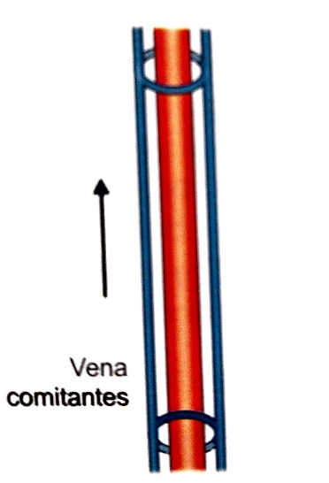
FACTORS HELPING IN VENOUS RETURN
Overflow from the capillaries, pushed from behind by the arteries
Negative intra thoracic pressure sucks the blood into the heart from all over the body.
Gravity helps venous return in the upper part of the body.
Arterial pulsations press on the vena comitantes intermittently and drive the venous blood towards the heart.
Venous valves prevent any regurgitation (back flow) of the luminal blood.
Muscular contractions press on the veins and form a very effective mechanism of venous return. This becomes still more effective within the tight sleeve of the deep fascia, as is seen in the region of calf. The calf muscle (soleus) for this reason are known as the peripheral heart. Thus the muscle pumps are the important factors in the venous return

Slide 31
COMPARISON BETWEEN ARTERIES AND VEINS
ARTERIES | VEINS
1. Arteries carry oxygenated blood, away from the heart except pulmonary trunk and pulmonary veins. | Veins carry deoxygenated blood, towards the heart except four pulmonary veins
2. These are mostly deeply situated in the body | These are superficial and deep in location
3. These are thick-walled, highly muscular except arteries of cranium and vertebral column | These are thinned-walled
4. These posses narrow lumen and valves are absent | These posses wide and lumen and valves are present which provide unidirectional flow of blood
5. These are reddish in colour. Arteries get empty at the time of death | These are bluish in colour and. Veins get filled up at time of death.
6. These show spurty flow of blood giving pulse. Blood in arteries moves with pressure. | These show sluggish flow of blood. Blood in veins moves under very low pressure.
If arterial wall is injured, the blood out like ‘fountain’ in large area all around the artery. | If venous wall is injured, blood comes out, collects in a pool in a small area around vein.

Slide 32
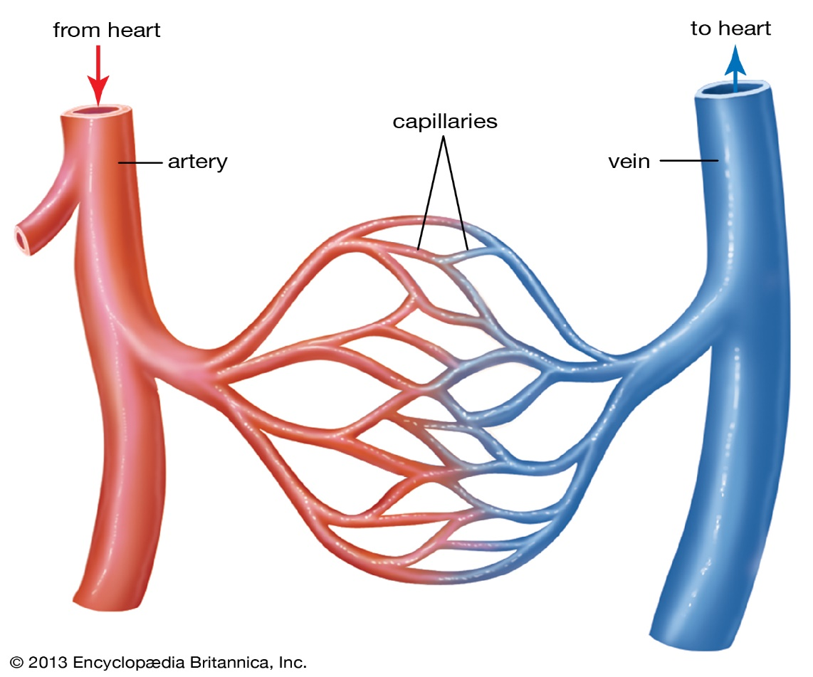
CAPILLARIES

Slide 33
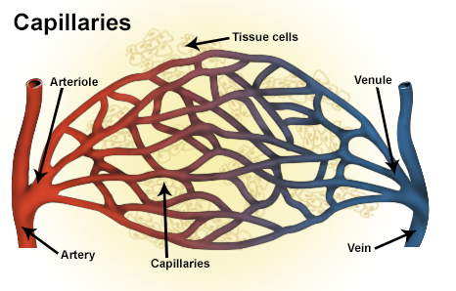
CAPILLARIES
Capillaries (Capillus= hair) are networks of microscopic endothelial tubes interposed between the arterioles and venules. The true capillaries (without any smooth muscle cell) begin after a transition zone of 50-60 micron beyond the precapillary sphincter.
The capillaries are replaced by cavernous(dilated) spaces in the sex organs, splenic pulp and placenta.
SIZE:
The average diameter of capillary is 6-8 micron, just sufficient to permit the red blood cells to pass through in ‘single file’. But the size varies from organ to organ. It is smallest in the brain and intestines, and is largest (20 micron) in the skin and the bone marrow.

Slide 34
TYPE AND STRUCTURE
The capillaries are classified as continuous and fenestrated according to the type of junctions between the endothelial cells.
Continuous capillaries : are found in the skin, connective tissue, skeletal and smooth muscles, lung and brain.
Fenestrated capillaries: are found in renal glomeruli/ intestinal mucosa, endocrine gland and pancreas.
Capillary with continuous lining
Capillary with fenestration

Slide 35
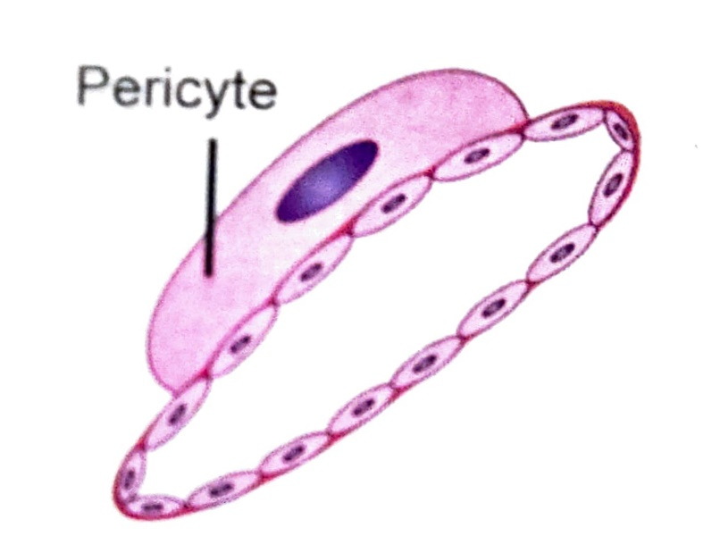
STRUCTURE
Pericytes – these are present on outer surface of capillaries and smallest venules, where there is no adventitia and muscle. Its procesess are wrapped around the endothelium.
Pericytes reveal contractile property act as stem cell.
Help in repair process and give rise to new blood vessels.

Slide 36
सिरा

Slide 37
परिचय
शरीर रचना विज्ञानं की दृष्टि से सम्पूर्ण शरीर में रस रक्त का संचार अथवा पूर्ण सवंहन सिरा धमनी और लसिका वाहिनियों पर निर्भर करता है |
सभी अवयवों का पोषण एवं संवर्धन भी इन्ही पर
निर्भर करता है |

Slide 38
सिरा की परिभाषा
सिरा शब्द का अभिप्राय: उन सभी प्रणालियों से है जो शरीर के रक्त को हृदय के तरफ ले जाती है |
ये सम्पूर्ण शरीर में फैली हुई है तथा अशुद्ध रक्त को वहन करने वाली है | इन सभी का आश्रय स्थान हृदय है जिस प्रकार सभी नदियों का समुद्र होता है ।

Slide 39
सिरा शब्द की व्युत्पत्ति
“सरणात् सिराः” [च०शा०30/12]
सिरा एक ऐसी संरचना है जहाँ पर सरण या संचरण की क्रिया होती है ।

Slide 40
“सरणाद् देशान्तरगमनात्” [चक्रपाणि]
जो शरीर के एक हिस्से से दूसरे हिस्से में गमन करता है उसे सिरा कहते है ।

Slide 41
“सरणात् रसादीनां गमनात् सिरा इति उच्यन्ते” [कविराज गंगाधर]
जो रस आदि धातुओं को एक स्थान से दूसरे स्थान तक ले जाता है उसे सिरा कहते है ।

Slide 42
स्वरुप
आचार्य सुश्रुत के अनुसार जैसे जलहारिणियों द्वारा उपवन का और क्यारियों व छोटे जलमार्गो द्वारा खेत का सिंचन और पोषण होता है उसी प्रकार सिराओं के आंकुचन और प्रसारण द्वारा शरीर का उपस्नेहन और परिपालन होता है |

Slide 43
उत्पत्ति
“तासां नाभिमूलं, ततश्च प्रसरन्त्युर्ध्वमधस्तर्यक् च”
[सु०शा० 7/3]
सिराओं का मूल स्थान नाभि है |
प्राणियों के शरीर में जितनी सिराएं उत्पन्न होती है, वे सभी नाभि से सम्भन्ध रखती हुई चारो ओर फैलती है ।

Slide 44
सिराओं की संख्या
सप्त सिरा शतानि भवन्ति [सु०शा० 7/3]
तासां मूल सिराश्चत्वारिशत् [सु०शा० 7/6]
सुश्रुत के अनुसार सिराएं 700 होती है परन्तु मूल सिराएं 40 होती है

Slide 45
इन सिराओं को 4 भागों में विभक्त किया गया है -
वातवह सिरा - 10
पित्तवह सिरा - 10
कफवह सिरा - 10
रक्तवह सिरा - 10
40

Slide 46
अंगानुसार गणना
प्रत्येक शाखा में = 25
अतः चारो शाखाओं में = 25x4 = 100
कोष्ठ में = 34
ऊर्ध्वजत्रुगत में = 41
कुल = 175

Slide 47
कोष्ठ की कुल 34 सिराएं
गुदा, शिश्न, श्रोणि में = 8
दोनों पार्श्व में = 4
पृष्ठ में = 6
उदर में = 6
वक्ष में =10
कुल =34

Slide 48
ऊर्ध्वजत्रुगत की कुल 41 सिराएं
कानो में = 4
जिह्वा में =9
नासिका में =6
नेत्रों में =8
ग्रीवा में =14
कुल =41
इसी प्रकार पित्त, कफ, और रक्तवह सिराएं भी अंगो में विभक्त होंगी अतः 175*4= 700 सिराएं
इसमें भेद सिर्फ इतना है की पित्तवाहिनी सिराएं आँखों में 10-10 और कानो में 2-2 होती है

Slide 49
सिराओं का सर्ववहत्व
देखा जाए तो वातादि प्रधान स्थानों में वातादि दोष वाहक सिराओं को वातादि का पोषण होने से वातवाहिनी, पित्तवाहिनी, कफवाहिनी और रक्तवाहिनी आदि नाम दिए गए है।
फिर भी प्रत्येक सिरा केवल वात, पित्त, कफादि का ही वहन नहीं करती है, किन्तु सिराएं प्रत्येक दोष एवं रक्त के पोषक रस का वहन करती है, इसी कारण इन्हे सर्ववहा कहा जाता है।
सभी सिराएं अपने अपने स्थान में होती हुई कार्य करती है, किन्तु दोष सर्व शरीर में व्याप्त है। अतः जब किसी दोष का प्रकोप होता है , तब भी वह दोष प्रत्येक सिरा द्वारा वहन कर स्थान विशेष में विकार उत्त्पन्न करता है। इसी कारण इनका सर्ववहत्व सिद्ध होता है।

Slide 50
सिराओं के कर्म वातवह सिराओं के प्राकृत कर्म
क्रियाणामतिघातममोहं बुद्धिकर्मणाम् करोत्यन्यान् गुणांश्चापि स्वाः सिराः पवनश्चरन् [सु०शा० 7/8]
जब शुद्ध वायु अपनी सिराओं से संचारित होती है तब सभी क्रियाएँ बिना बाधा के होती है।
क्रियाणाम - इन क्रियाओं में हाथ - पाँव आदि अवयवों के आंकुचन प्रसारण आदि ऐच्छिक और हृदयतंत्र आदि अवयवों के आंकुचन प्रसारण आदि अनैच्छिक कर्म भी सम्मिलित है।
बुद्धिकर्मणां - वे स्वाभाविक रूप से अपने कार्य व्यवसाय निर्मोह होकर करती है । शेष सभी स्पंदन आदि कर्म भी अच्छी तरह से होते है। बल,वर्ण,और ओज की वृद्धि होती है।

Slide 51
वातवह सिराओं के वैकृत कर्म
तदा तु कुपितो वायुः स्वाः सिरा: प्रतिपद्दते तदाऽस्य विविधा रोगा जायन्ते वातसंभवा [सु०शा० 7/9]
जब कुपित वात अपनी सिराओं में संचार करता है तब शरीर में अनेक प्रकार के वातजन्य रोग उत्पन्न होते है ।
जैसे - जोड़ो में वेदना, पेट में अफरा आदि। इन्ही विकृत सिराओं के द्वारा ही कई बार गर्भ, गर्भाशय में ही मर जाता है ।

Slide 52
पित्तवह सिराओं के प्राकृत कर्म
भ्राजिष्णुतामन्नरुचिमग्निदीप्तीमारोगतम ।
संसर्पत् स्वाः सिराः पित्तं कुर्याच्चान्यान् गुणानपि [सु०शा० 7/10]
प्राकृत पित्त के अपने सिराओं में संचार करने में निम्नलिखित कार्य होते है –
शरीर में कान्ति उत्पन्न करना
अन्न में रूचि उत्पन्न करना
जठराग्नि की प्रखरता करना
निरोगता को उत्पन्न करना
पाचन क्रिया को सामान रखना

Slide 53
पित्तवह सिराओं के वैकृत कर्म
यदा प्रकुपित पित्तं सेवेत स्ववहा: सिराः
सदाऽस्य विविधा रोगा जायन्तं पित्तसंभ्वाः [सु०शा० 7/11]
जब कुपित पित्त अपनी सिराओं का आश्रय लेता है तब शरीर की अन्न पाचन संस्थान सम्बंधित क्रियाएँ विकृत हो जाती है ।
साथ ही अनेक प्रकार के अन्य पित्तजन्य रोग भी उत्तपन्न हो जाते है जैसे - अम्लपित्त कण्डु त्वचा का फटना आदि ।

Slide 54
कफवह सिराओं के प्राकृत कर्म
स्नेहमङ्गेषु सन्धीनां स्थैर्यं बलमुदीर्णताम्
करोत्यन्यान् गुणांश्चापि बलासः स्वाः सिराश्चरन् [सु०शा० 7/12]
प्राकृत कफ अपनी सिराओं में संचार करे तो –
शरीर के प्रत्येक अंग में चिकनाई उत्पन्न करता है
संधियों को स्थिर रखता है
शक्ति प्रधान करता है
उत्साह उत्पन्न करता है
संधियों में रहता हुआ उनको घर्षण से बचता है

Slide 55
कफवह सिराओं के वैकृत कर्म
यदा तु कुपितः श्लेष्मा स्वा: सिराः
तदाऽस्य विविधा रोगा जायन्ते श्लेष्मसंम्भवः [सु०शा० 7/13]
जब कुपित हुआ कफ अपनी सिराओं में संचार करता है तब शरीर में अनेक प्रकार के कफजन्य विकार उत्पन्न हो जाते है । जैसे निद्रा का अधिक आना, अरुचि,भारीपन एवं उपर्युक्त सभी क्रियाओं में बाधा आ जाती है ।

Slide 56
रक्तवह सिराओं के प्राकृत कर्म
धातूनां पूरणं वर्णं स्पर्शज्ञानमसंशयम्
स्वाः सिराः सञ्चरद्रक्तं कुर्याच्चान्यान् गुणानपि [सु०शा० 7/14]
अपनी सिराओं में संचरण करता हुआ प्राकृत रक्त निम्नलिखित कार्य करता है –
धातुओं का पोषण करता है
शरीर की वृद्धि करता है
वर्ण का दर्शाता है
स्पर्श ज्ञान को उत्पन्न करता है
शक्ति प्रधान करता है

Slide 57
रक्तवह सिराओं के वैकृत कर्म
यदा तु कुपितं रक्तं सेवेत स्ववहा: सिराः
तदास्य विविधा रोगा जायन्ते रक्तसंभवा: [सु०शा० 7/15]
विकृत रक्त जब अपनी सिराओं में संचार करा है तब शरीर की सभी क्रियाओं में बाधाएं आ जाती है । अनेक प्रकार क रक्तजन्य रोग उत्पन्न हो जाते है जैसे- रक्त-पित्त, फोड़े, रक्तचांप का बढ़ना ।

Slide 58
अवेध्य सिराएं
शरीर में कुछ ऐसी सिराएं भी होती है जिनके वेध होने से मृत्यु अथवा विकलता होती है । अधिकतर ये सिराएं मर्म स्थान से सम्बंधित होती है।

Slide 59
अवेध्य सिराएं की संख्या
शरीर में अवेध्य सिराएं 98 होती है जिनका वर्णन इस प्रकार है-
शाखासु षोडस सिरा: कोष्ठे द्वात्रिंशदेव तु।
पञ्चाशज्जत्रुणश्चोर्ध्वमवध्याः परिकीर्तिताः ।
सखाओं की कुल सिराओं में अवेध्य सिराएं 16 होती है ।
कोष्ठ की कुल सिराओं में अवेध्य सिराएं 32 होती है ।
ग्रीवा और ग्रीवा के ऊपर की कुल सिराओं में अवेध्य सिराएं 50 होती है ।
इस प्रकार कुल अवेध्य सिराएं 98 होती है ।

Slide 60
संख्या
शाखाओं की कुल अवेध्य सिरायें = 16
मध्य शरीर की कुल अवेध्य सिरायें = 32
ग्रीवा और ग्रीवा से ऊपर की कुल अवेध्य सिरायें = 50
कुल = 98

Slide 61
शाखाओं की कुल 16 अवेध्य सिराएं
प्रत्येक शाखा में 100 सिराएं होती है जिनमे से प्रत्येक शाखा में 4 अवेध्य सिरा होती है |
शाखा की अवेध्य सराएँ निम्नलिखित है-
जालधरा (बहरी 1)
उर्वी (अन्दर 2)
लोहिताक्ष (1)
कुल = 4
इसी प्रकार सभी सखाओ की अवेध्य सिराओ को जोड़ने पर 16 होती है

Slide 62
मध्य शरीर की कुल 32 अवेध्य सिरायें
श्रोणि प्रदेश में = 8
पार्श्व में = 4
पृष्ठ में = 2
उदर में = 14
छाती में = 14
कुल = 32

Slide 63
ग्रीवा और ग्रीवा से ऊपर की कुल 50 अवेध्य सिरायें
ग्रीवा में = 16
हनु में = 4
जिह्वा में = 4
नासा में = 5
नेत्रों में = 2
कान में = 2
ललाट में = 7
शंखप्रदेश में = 2
सिर में = 8
कुल = 50

Slide 64
THANK YOU

