Slide 1
CONCEPT OF RESPIRATORY PHYSIOLOGY IN MODERN
JEEVAK AYURVEDIC MEDICAL COLLEGE
PRESENTED BY-
RANJEET KUMAR
ALOK KUMAR
GUIDED BY-
DR.POORNIMA PRABHAKAR DR.SAMEER SINGH RATHOUR

Slide 2
CONCEPT OF RESPIRATORY PHYSIOLOGY IN MODERN

Slide 3
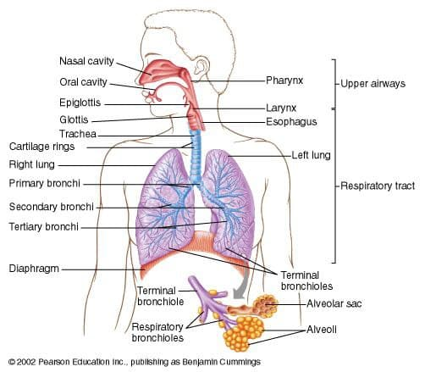
PHYSIOLOGICAL ANATOMY OF RESPIRATORY SYSTEM
●The respiratory system consist of the nasal cavity, pharynx, larynx, trachea, bronchi, and lungs, which is whole together called as respiratory tract.
●Upper respiratory tract refers to : Nasal cavity, pharynx, and associated structures.
●Lower respiratory tract refers to : Larynx, trachea, bronchi, and lungs.

Slide 4
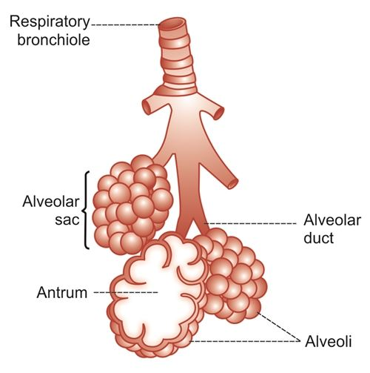
RESPIRATORY UNIT
Respiratory unit is the terminal portion of the respiratory tract . It includes :
Respiratory bronchioles
Alveolar ducts
Antrum
Alveolar sacs
Alveoli

Slide 5
RESPIRATION
Respiration is the process by which oxygen is taken in and carbon dioxide is given out .The first breath takes place only after birth .After the first breath , the respiratory process continues throughout the life . Permanent stoppage of respiration occurs only at death.
NORMAL RESPIRATORY RATE AT DIFFERENT AGE
●Newborn : 30 to 60/min
●Early childhood : 20 to 40/min
●Late childhood : 15 to 25/min
●Adult : 12 to 16/min

Slide 6
TYPES OF RESPIRATION
Respiration is classified into two types :
External respiration : External respiration that involves exchange of respiratory gases , i.e. oxygen and carbon dioxide between lungs and blood .
Internal respiration : Internal respiration which involves exchange of gases between blood and tissues.

Slide 7
BRONCHIAL TREE
CONDUCTING ZONE Ext. nostrils → Vestibule → Nasal chamber → Internal nares → Nasopharynx → Pharynx → Larynx →Trachea → Primary bronchi→ Secondary bronchi → Tertiary bronchi → Total pulmonary bronchioles → Terminal bronchioles
RESPIRATORY ZONE/EXCHANGE ZONE
Respiratory bronchioles → Alveolar duct → Atria → Alveolar sac → Alveoli

Slide 8
RESPIRATORY FUNCTIONS
Pulmonary ventilation
Diffusion of oxygen and carbon dioxide between alveoli and the blood .
Transportation of oxygen and carbon dioxide in the blood and body fluids to and from the body tissue’s cells .
Regulation of ventilation .
NON RESPIRATORY FUNCTIONS
●Olfaction , Vocalization
●Defense mechanism
●Anticoagulant function
●Regulation of body temperature and acid base balance

Slide 9
Maintenance of water balance
Secretion of ACE Angiotensin converting enzyme
MECHANISM OF RESPIRATION
Primary inspiratory muscles : primary inspiratory muscles are diaphragm , which is supplied by phrenic nerve ( C3 to C5 ) and external intercostal muscles, supplied by intercostal nerves ( T1 to T11 )
Accessory inspiratory muscles : sternocleidomastoid , scalene , anterior serrati , elevators of scapulae .

Slide 10
RESPIRATORY MEMBRANE
●It consist of following layers :
- A layer of fluid lining the alveolus and containing surfactant that reduces the surface tension of the alveolar fluid
-Alveolar epithelium composed of thin epithelial cells
-Epithelial basement membrane
-Thin interstitial space between the alveolar epithelium and the capillary membrane
-Capillary basement membrane that in many places fuses with the alveolar epithelial basement membrane
-Capillary endothelial membrane

Slide 11
●Thinnest at 0.2 micrometer , and it averages about 0.6 micrometer .
●Normal adult human male : Total surface area =70 m ²
●Oxygen and carbon dioxide need not pass through significant amounts of plasma
- they diffuse between the alveolus and the red cell
- pulmonary capillary diameter 6 micrometer.
●All this factors allow rapid diffusion of gases across the membrane .

Slide 12
Pectorals are the accessory inspiratory muscles.
EXPIRATORY MUSCLES
●Primary expiratory muscles : primary expiratory muscles are the internal intercostal muscles , which are innervated by intercostal nerves .
●Accessory expiratory muscles : Accessory expiratory muscles are the abdominal muscles .

Slide 13
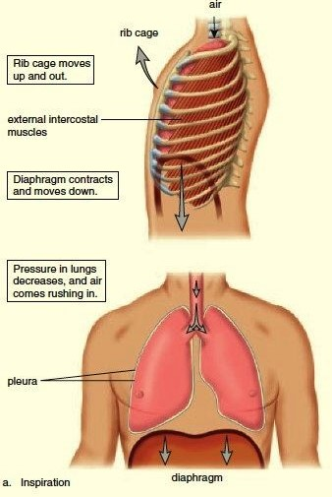
INSPIRATION
●Diaphragm muscles contracts , increasing thoracic cavity size in the superior –inferior dimension .
●External intercostal muscles contracts , expanding lateral and anterior–posterior dimension.
●Increased volume ( about 0.5 liter) , decreased pulmonary pressure ( -1 mm Hg ) , air rushes into lungs to fill alveoli .
●Deep/forced inspirations – as during exercise and pulmonary disease

Slide 14
MECHANISM OF INSPIRATION
Inspiration is active process during inspiration the thorax is enlarged by
Movement of the 2nd to 6th ribs obliquely downwards and forward and 7th to 10th outward and upward.
Descent of diaphragm

Slide 15
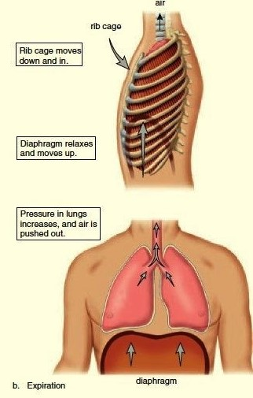
EXPIRATION
At the end of inspiration the muscles which contracts actively during inspiration relax and the elastic recoil of the thoracic wall and lungs cause passive expiration .

Slide 16
MECHANISM OF EXPIRATION
Normally it is a passive process but during forced expiration, the muscles of expiration contracts which includes
●Anterior abdominal wall muscles
●Internal intercostal muscles

Slide 18
MOVEMENTS OF LUNGS
During inspiration , due to the enlargement of thoracic cage , negative pressure is increased in the thoracic cavity . It causes expansion of lungs . During expiration ,the thoracic cavity decreases in size to the pre-inspiratory position. Pressure in the thoracic cage also comes back to the pre-inspiratory level . It compresses the lung tissues so that , the air is expelled out of lungs .

Slide 19
SURFACTANT
Surfactant is a surface acting material or agent that is responsible for lowering the surface tension of fluid .Surfactant that lines the epithelium of alveoli in lungs is known as pulmonary surfactant and it decreases the surface tension on the alveolar membrane .
SOURCE OF SECRETION OF PULMONARY SURFACTANT
Pulmonary surfactant is secreted by two types of cells :
1- Type II alveolar epithelial cells in the lungs , which are called surfactant secreting alveolar cells or pneumocytes. Characteristic feature of these cells is the presence of microvilli on their alveolar surface .
2- Clara cells , which are situated in the bronchioles . These cells are also called bronchiolar exocrine cells .

Slide 20
●CHEMISTRY OF SURFACTANT
Surfactant is a lipoprotein complex formed by lipid specially phospholipids , proteins ,and ions .
1- PHOSPHOLIPIDS : Phospholipid form about 75% of the surfactant .
2- OTHER LIPIDS : Other lipid substances of surfactant are triglycerides and phosphotidylglycerol ( PG).
3- PROTEINS : Proteins of surfactant are called specific surfactant proteins .
4- IONS : Ions present in the surfactant are mostly calcium ions.

Slide 21
EFFECT OF DEFICIENCY OF SURFACTANT
Respiratory distress syndrome :
Respiratory distress syndrome or hyaline membrane disease is the condition characterized by collapse of lungs because of absence of surfactant in infants . Deficiency of surfactant occurs in adults also and it is called adult respiratory distress syndrome (ADRS).
VENTILATION
Ventilation refers to circulation of air or replacement of stale ( not fresh) air with fresh air in a space . In respiratory physiology , ventilation is the rate at which air enters or leaves the lungs.
Ventilation is of two types :
1.Pulmonary ventilation
2.Alveolar ventilation

Slide 22
PULMONARY VENTILATION
The volume of air moving in and out of respiratory tract in a given unit of time during quiet breathing . It is also called minute ventilation or respiratory minute volume (RMV).
Pulmonary ventilation is a cyclic process, by which fresh air enters the lungs and an equal volume of air leaves the lungs .
Normal value = 6000 ml( 6L)
Pulmonary ventilation = Tidal volume x Respiratory rate
= 500 ml x 12/min
= 6,000 mL/min

Slide 23
ALVEOLAR VENTILATION
Alveolar ventilation is the amount of air utilized for gaseous exchange every minute .
Alveolar ventilation is different from pulmonary ventilation . In pulmonary ventilation , 6L of air moves in and out of respiratory tract every minute . But the whole volume of air is not utilized for exchange of gases . Volume of air subjected for exchange of gases is the alveolar ventilation . Air trapped in respiratory passage does take part in gaseous exchange .
Normal value of alveolar ventilation is 4,200 mL(4.2 L)/min.
Alveolar ventilation =
( Tidal volume – Dead space) x Respiratory rate
= (500 – 150)mL x 12/min
=4,200 mL (4.2 L)/min

Slide 24
RESPIRATORY PRESSURES
Two types of pressures are exerted in thoracic cavity and lungs during process of respiration :
1-Intrapleural pressure or intrathoracic pressure .
2-Intra-alveolar pressure or intra-pulmonary pressure .
INTRAPLEURAL PRESSURE
Intrapleural pressure is the pressure existing in pleural cavity ,i.e. in between the visceral and parietal layers of pleura . It is exerted by the suction of the fluid that lines the pleural cavity . It is also called intrathoracic pressure since it is exerted in the whole of thoracic cavity.

Slide 25
NOMAL VALUES OF INTRAPLEURAL PRESSURE
Respiratory pressures are always expressed in relation to atmospheric pressure, which is 760 mm Hg . Under physiological conditions , the intra pleural pressure is always negative .
CONDITION | INTRAPLEURAL PRESSURE
At the end of normal respiration | -6 mm Hg(754 mm Hg)
At the end of normal expiration | -2 mm Hg( 758mm Hg)
At the end of forced inspiration | -30 mm Hg
During forced inspiration with closed glottis | -70 mm Hg
During forced expiration with closed glottis | -50 mm Hg

Slide 26
INTRA-ALVEOLAR PRESSURE
Intra-alveolar pressure is the pressure existing in the alveoli of lungs. It is also known as intrapulmonary pressure .
NORMAL VALUES OF INTRA-ALVEOLAR PRESSURE
Normally , intra-alveolar pressure is equal to the atmospheric pressure , which is 760 mm Hg . It becomes negative during inspiration and positive during expiration .
CONDITION | INTRA-ALVEOLAR PRESSURE
During normal inspiration | -1 mm Hg (759 mm Hg)
During normal expiration | +1 mm Hg (761 mm Hg )
At the end of inspiration and expiration | Equal to atmospheric pressure :760 mm Hg
During forced inspiration with closed glottis | -80 mm Hg
During forced expiration with closed glottis | +100 mm Hg

Slide 27
PULMONARY FUNCTION TESTS
Pulmonary function tests or lung function test are useful in assessing the functional status of the respiratory system both in physiological and pathological conditions . Lung function tests are based on the measurement of volume of air breathed in and out in quiet breathing and forced breathing .These tests are carried out mostly by using spirometer.
TYPES OF LUNGS FUNCTION TESTS
Lung function tests are of two types :
1-Static lung function tests.
2-Dynamic lung function tests.

Slide 28
STATIC LUNG FUNCTION TESTS
Static lung function tests are based on volume of air that flows into or out of lungs . These tests do not depend upon the rate at which air flows .
Static lung function tests include static lung volumes and static lung capacities .
DYNAMIC LUNG FUNCTION TESTS
Dynamic lung function tests are based on time ,i.e. the rate at which air flows into or out of lungs .These tests include forced vital capacity , forced expiratory volume , maximum ventilation volume and peak expiratory flow .
Dynamic lung function tests are useful in determining the severity of obstructive and restrictive lung diseases.

Slide 29
LUNG VOLUMES
Static lung volumes are the volumes of air breathed by an individual . Each of these volumes represents the volume of air present in the lung under a specified static condition ( specific position of thorax ).
Static lung volumes are four types :
1-Tidal volume
2-Inspiratory reserve volume
3-Expiratory reserve volume
4-Residual volume

Slide 30
●TIDAL VOLUME
Tidal volume (TV) is the volume of air breathed in and out of lungs in a single normal quiet respiration. Tidal volume signifies the normal depth of breathing .
Normal Value :500ml ( 0.5L)
●INSPIRATORY RESERVE VOLUME
Inspiratory reserve volume (IRV) is an additional volume of air that can be inspired forcefully after the end of normal respiration .
Normal value : 3300ml (3.3L)
●EXPIRATORY RESERVE VOLUME
Expiratory reserve volume (ERV) is the additional volume of air that can be expired out forcefully , after normal expiration .

Slide 31
Normal value : 1000 ml (1L)
●RESIDUAL VOLUME
Residual volume (RV) is the volume of air remaining in lungs even after forced expiration .Normally , lungs cannot be emptied completely even by forceful expiration .Some quantity of air always remains in the lungs even after the forced expiration .
Residual volumes are significant because of two reasons :
1-It helps to aerate the blood in between breathing and during expiration .
2-It maintains the contour of the lungs .
Normal value : 1200 ml (1.2 L)

Slide 32
LUNG CAPACITIES
Static lung capacities are the combination of two or more lung volumes .
Static lung capacities are four types :
1-Inspiratory capacity
2-Vital capacity
3-Functional residual capacity
4-Total lung capacity
●INSPIRATORY CAPACITY
Inspiratory capacity (IC) is the maximum value of air that is inspired after normal expiration . It include tidal volume and inspiratory reserve volume.

Slide 33
IC =TV+IRV
=500+3300 =3800 ml
●VITAL CAPACITY
Vital capacity (VC) is the maximum volume of air that can be expelled out forcefully after a deep ( maximal) inspiration .VC includes inspiratory reserve volume , tidal volume and expiratory reserve volume .
IC=IRV+TV+ERV
=3300+500+1000=4800 ml
Vital capacity is significant physiologically and its determination is useful in clinical diagnosis.
●FUNCTIONAL RESIDUAL CAPACITY
Functional residual capacity (FRC) is the volume of air remaining in lungs after normal expiration (after normal tidal expiration .

Slide 34
Functional residual capacity includes expiratory reserve volume and tidal volume
FRC=ERV+RV
1000+1200=2200 ml
●TOTAL LUNG CAPACITY
Total lung capacity (TLC) is the volume of air present in lungs after a deep ( maximal ) inspiration . It include all the volumes .
TLC= IRV+TV+ERV+RV
=3300+500+1000+1200 = 6000 ml

Slide 35
DEAD SPACE
Dead space is defined as the part of the respiratory tract , where gaseous exchange does not take place . Air present in the dead space is called dead space air .
●TYPES OF DEAD SPACE
1-Anatomical dead space .
2-Physiological dead space .
1-Anatomical dead space: Anatomical dead space extends from nose up to terminal bronchioles . It includes nose , pharynx , trachea, bronchi and branches of bronchi up to terminal bronchioles . These structures serve only as the passage for air movement . Gaseous exchange does not take place in these structures .

Slide 36
2-Physiological dead space : Physiological dead space include anatomical dead space plus two additional volumes .
Additional volumes included in physiological dead space are :
1.Air in the alveoli , which are non functioning .In some respiratory diseases , alveoli do not function because of dysfunction or destruction of alveolar membrane .
2. Air in the alveoli ,which do not receive adequate blood flow. Gaseous exchange does not take place during inadequate blood supply .
NORMAL VALUE OF DEAD SPACE
Volume of normal dead space is 150mL . Under normal condition , physiological dead space is equal to anatomical dead space . It is because , all the alveoli are functioning and all the alveoli receive adequate blood flow in normal condition.
Physiological dead space increases during respiratory diseases , which affect the pulmonary blood flow or the alveoli .

Slide 37
GASES EXCHANGE

Slide 38
EXCHANGE OF RESPIRATORY GASES IN LUNGS
In the lungs , exchange of respiratory gases takes place between the alveoli of lungs and the blood . Oxygen enters the blood from alveoli and carbon dioxide is expelled out of blood into alveoli.
Exchange occurs through bulk flow diffusion

Slide 39
DIFFUSING CAPACITY
Diffusing capacity is defined as the volume of gases that diffuses through the respiratory membrane each minute for a pressure gradient of 1 mm Hg .
●Diffusing capacity for oxygen and carbon dioxide
-Diffusing capacity for oxygen is 21 mL/min/1 mm Hg.
-Diffusing capacity for carbon dioxide is 400 mL/min/ 1 mmHg.
Thus , diffusing capacity for carbon dioxide is 20 times more than that of oxygen.

Slide 40
●Factors affecting diffusing capacity :
1-Pressure gradient
2-Solubility of gas in fluid medium
3-Total surface area of respiratory membrane
4-Molecular weight of the gas
5-Thickness of respiratory membrane
TRANSPORT OF GASES
●It involves following steps :
1.Diffusion of oxygen from the alveoli to the pulmonary capillary blood .
2.Transport of oxygen in the arterial blood .

Slide 41
3. Diffusion of oxygen from the peripheral capillaries into the tissue fluid and tissue cells . -Concentration gradient for oxygen from alveoli to blood and blood to tissue. -Concentration gradient for CO₂ in the opposite direction i.e., from tissue to blood and blood to alveoli.

Slide 42
4.Diffusion of carbon dioxide from the peripheral tissue cells into the peripheral capillaries .
5. Transport of carbon dioxide in venous blood .
6. Diffusion of carbon dioxide from the pulmonary capillaries into the alveoli .
TRANSPORT OF OXYGEN
-Oxygen is transported from alveoli of lungs to the cells by blood in two forms:
1.As simple physical solution (3%).
2.In combination with hemoglobin (97%).
●AS SIMPLE SOLUTION
Oxygen dissolves in water of plasma and is transported in this physical form . Amount of oxygen transported in this way is very negligible .

Slide 43
It is only 0.3 mL/100mL of plasma .It forms only about 3% of total oxygen in blood . It is because of poor solubility of oxygen in water content of plasma .
●IN COMBINATION WITH HEMOGLOBIN
-Oxygen combined with hemoglobin in blood and is transported as oxy-hemoglobin . Transport of oxygen in this form is important , because amount (97%) of oxygen is transported by this method .
OXYGEN-HEMOGLOBIN DISSOCIATION CURVE
-Oxygen- hemoglobin dissociation curve is the curve that demonstrates the relationship between partial pressure of oxygen and the percentage saturation of hemoglobin with oxygen . It explains hemoglobin affinity for oxygen .

Slide 44
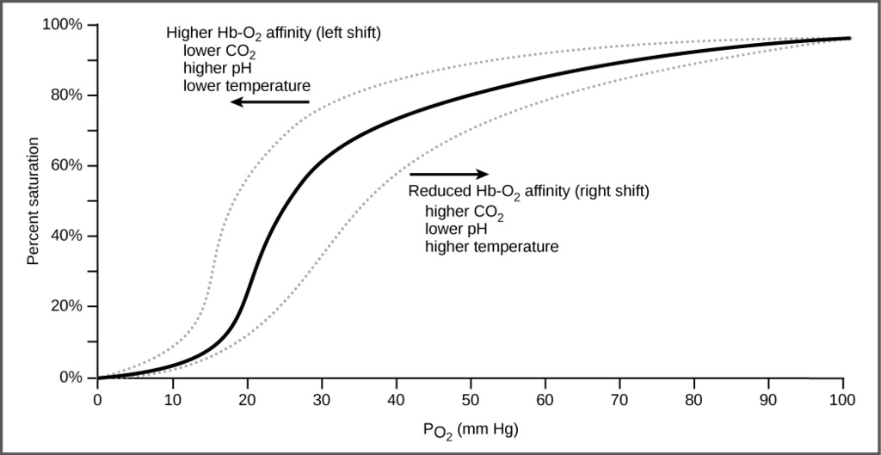
●Factors affecting Oxygen-hemoglobin dissociation curve
-Oxygen- hemoglobin dissociation curve is shifted to left or right by various factors :
1. Shift to left indicates acceptance (association) of oxygen by hemoglobin .

Slide 45
2.Shift to right indicates dissociation of oxygen from hemoglobin .
●SHIFT TO RIGHT
-Decreases in partial pressure of oxygen.
-Increase in partial pressure of carbon dioxide .
-Increase in hydrogen ion concentration and decrease in pH
-Increased body temperature .
-Excess of 2,3-diphosphoglycerate (DPG) in RBC.
●SHIFT TO LEFT
-In fetal blood , because fetal hemoglobin has got more affinity for oxygen then the adult hemoglobin .
-Decrease in hydrogen ion concentration and increases in pH

Slide 46
●This curve is called oxygen dissociation curve and is highly useful in studying the effect of factors like pCO₂ , H⁺ concentration ,etc. on binding of O₂, with hemoglobin.
●IN ALVEOLI
-High pO₂ , low pCO₂ , lesser H⁺ concentration , and lower temperature , the factors are all favourable for the formation of oxy-hemoglobin.
●IN TISSUE
-Low pO₂, High pCO₂, High H⁺ concentration and higher temperature exist, the condition are favourable for dissociation of oxygen from the oxy-hemoglobin .

Slide 47
TRANSPORT OF CARBON DIOXIDE
Carbon dioxide is transported from the cells to alveoli of lungs by the blood from cells in four forms:
1.As dissolved form (7%).
2.As carbonic acid (negligible).
3.As bicarbonate (70%).
4.As carbamino compounds(23%).
1.As dissolved form : The smallest percentage- about 7%- is dissolved in blood plasma . On reaching the lungs , it diffuses into alveolar air and is exhaled.

Slide 48
2.Carbamino compounds : About 23% of CO₂, combines with the amino groups of amino acid and proteins in blood to form carbamino compounds. The main CO₂ binding sites are the terminal amino acids in the two alpha and two beta globin chains.
3. Bicarbonate ions: The greatest percentage of CO₂ about 70%- is transported in blood plasma as bicarbonate ions.

Slide 49
MECHANISM OF REGULATION OF RESPIRATION
●There are two major mechanism :
1.Nervous regulation of respiration
2.Chemical regulation of respiration
1.Nervous regulation of respiration
Respiratory center : The respiratory center are divided into four major groups , two in the medulla and two in the pons.
The two groups in the medulla are :
A. The dorsal respiratory group
B .The ventral respiratory group
The two groups in the pons are:
A. Pneumotaxic center
B.Apneustic center
also known as the pontine respiratory group .

Slide 50
●Respiratory centers can be divided into three areas on the basis of their function :
1.The medullary rhythmicity area in the medulla oblongata .
2.The pneumotaxic areas in the pons .
3.The apneustic area, also in the pons

Slide 51
RESPIRATORY AREAS IN THE BRAINSTEM
Medullary respiratory center
-Dorsal group stimulate the external intercostal muscles and diaphragm.
-Ventral group stimulate the internal intercostal muscles and accessory respiratory muscles.
Pontine respiratory group
-Involved with switching between inspiration and expiration.

Slide 52
MEDULLARY RHYTHMICITY AREA
●The function of the medullary rhythmicity area is to control the basic rhythm of respiration .It includes two areas
a. Inspiratory medullary rhythmicity area or respiratory center
b. Expiratory medullary rhythmicity area or expiratory center .
a. Inspiratory center
It establish the basic rhythm of breathing .When its inspiratory neurons fire , a burst of impulse travels along the phrenic and intercostal nerves to excite the diaphragm and external intercostal muscles.

Slide 53
b. Expiratory center
Impulse from the respiratory area cause contraction of the internal intercostal muscles abdominal muscles , which decreases the size of the thoracic cavity and cause forceful exhalation.
PNEUMOTAXIC AREA
●It transmit inhibitory impulse to the inspiratory area . The major effect of these nerve impulse is to help turn off the inspiratory area before the lung become too full of air .

Slide 54
APNEUSTIC AREA
This area send stimulatory impulse to the inspiratory area that activate it and prolong inhalation .The result is a long , deep inhalation .

Slide 55
2. Chemical regulation of respiration
●There are three important chemical factor controlling respiration :
1.Concentration of CO₂ in blood
2.Concentration of H⁺ ions or pH
3.Concentration of oxygen in blood
Concentration of CO₂ in blood
●When CO₂ concentration in blood increases ,it stimulates the chemoreceptors . There are two groups of chemoreceptors
1.Peripheral chemoreceptors – situated at the carotid body and aortic body
2.Central chemoreceptors – situated at the medulla oblongata

Slide 56
When CO₂ concentration in blood increases
↓
Stimulates the chemoreceptors
↓
Transmission of sensory impulse to respiratory centers
↓
Activation of respiratory centers
↓
Increases the activities of respiration ( rate and depth)
↓
Increases alveolar ventilation
↓
Expulsion of CO₂ and decreases the level of CO₂ in blood

Slide 57
Concentration of H⁺ ions or pH
When concentration of H⁺ ions increases , it stimulates the peripheral chemoreceptors .
H⁺ ions diffuses with CO₂ and form carbonic acid , to cross the blood brain barrier then dissociates into H+ and HCO₃. There by H+ ions stimulates the central chemoreceptors then the respiratory centers , resulting a reduction in the level of CO₂ in blood . This will in turn decrease concentration of H+ in blood or increase the pH in to normal

Slide 58
CONCENTRATION OF OXYGEN IN BLOOD
When O₂ concentration in blood decreases
↓
Stimulates the peripheral chemoreceptors
↓
Transmission of impulse to respiratory centers
↓
Activation of respiratory centers
↓
Increases the activities of respiration (rate and depth )
↓
Increases alveolar ventilation
↓
Increases the uptake of O₂
↓
There by increase the level of O₂ in blood

Slide 59
CLINICAL ASPECT
HYPOXIA
●Hypoxia is O₂ deficiency at the tissue level.
●A pathological condition in which the whole body as a whole or a region of body is deprived of adequate oxygen supply
●It is the decrease below the normal levels of oxygen in inspired gases, arterial blood , or tissues, without reaching anoxia.

Slide 60
CAUSES
-High altitude
-Low hemoglobin level
-Decreases oxygen supply to an area
-Low oxygen carrying capacity
-Poor tissue perfusion
-Impaired ventilation
-Decreased diffusion of oxygen
TYPES
-Hypoxic hypoxia
-Anemic hypoxia
-Stagnant hypoxia
-Histotoxic hypoxia

Slide 61
DEFINITIONS
Types of hypoxia | Arterial pO₂ | Hemoglobin count | Rate of blood flow to tissue
Hypoxic hypoxia | Decreases | Normal | Normal
Anemic hypoxia | Normal | Decreases | Normal
Stagnant hypoxia | Normal | Normal | Decreases
Histotoxic hypoxia | Normal | Normal | Normal

Slide 62
CAUSES
TYPES OF HYPOXIAS | CAUSES
Hypoxic hypoxia | Decreases in inspired pO₂; decreased pulmonary ventilation
Anemic hypoxia | Total Hb content decreases due to anemia ; haemorrhage ; presence of abnormal Hb
Stagnant hypoxia | Circulatory failure ; haemorrhage ; heart failure
Histotoxic hypoxia | Cyanide poisoning

Slide 63
TREATMENT OF HYPOXIA
It includes :
●Treatment of the underlying cause . It depends on the type of hypoxia .
●Oxygen therapy

Slide 64
ASPHYXIA
Asphyxia is the condition caused by lack of oxygen and excess of carbon dioxide in blood that occurs due to obstruction of air passage.
-It is produced by occlusion of airways .This result in (lack of O₂)and Hypercapnia (excess of CO₂).
-Experimentally , asphyxia can be produced in animal by connecting him to a closed bag for respiration ,after some time O₂ gets utilized and CO₂ increases producing :
1.Initially there will be marked stimulation of respiration with violent respiratory efforts ;
2.Blood pressure and heart rate increases
3.Increased catecholamine secretion (epinephrine and nor-epinephrine)
4.Blood pH falls

Slide 65
ARTIFICIAL RESPIRATION
In respiration with acute asphyxia , respiration may be life saving measure .Drowning , electrocution , anesthetic accident , carbon monoxide poisoning ,etc. cause acute respiratory failure and can be treated effectively by artificial respiration . Artificial respiration is also useful in patients with self limiting ventilatory failure .
Eg. Paralysis of respiratory muscles due to a viral infection (polio).

Slide 66
THANK YOU

