Slide 1
Jeevak Ayurveda Medical College and Hospital Research Centre.
Concept of Ashtyavidhapariksha and its Clinical Significance.
Presented by:
Vandana Kumari
Praditi Raut
(Batch 2021-22)
Guided by:
Dr. Ashok Bhattacharya
Dr. Awanish Jaiswal

Slide 2
आयुर्वेद का प्रयोजन स्वस्थ व्यक्तियों के स्वास्थ्य की रक्षा तथा आतुरों के रोग का प्रशमन हैं। विकार-प्रशमन से पूर्व रोग-ज्ञान करना अत्यावश्यक होता है।
रोगों का ज्ञान दो प्रकार से प्राप्त किया जाता है-
रोग-परीक्षा द्वारा, तथा
रोगी-परीक्षा द्वारा।

Slide 3
रोग-परीक्षा
पञ्च रोग निदान
रोगं निदानप्राग्रूपलक्षणोपशयाप्तिभिः|
(अ.हृ.सू.1/ 22)
निदानं पूर्वरूपाणि रूपाण्युपशयस्तथा ।
सम्प्राप्तिश्चेति विज्ञानं रोगाणां पञ्चधा स्मृतम् ।।
(मा० नि० पञ्चनि० 4 )
निदानपञ्चक
निदान (हेतु)
पूर्वरूप
रूप
उपशय
संप्राप्ति

Slide 4
रोगी-परीक्षा
रोगी की परीक्षा का प्रयोजन:-
मिथ्या दृष्टा विकारा ये दुराख्यातास्तथैव च ।
तथा दुष्परिमृष्टाश्च मोहयेयुश्चिकित्सकम् ।।
(सु० सू० 10/ 5 )
जिन रोगियों की परीक्षा विधिवत् नहीं की जाती है, उनका सही विवरण नहीं एकत्र किया जाता है और जिनके विषय में चिकित्सक ने पूर्णतः विचार नहीं किया है, ऐसे रोगी के रोग, वैद्य को कर्तव्यज्ञान शून्य बना देते हैं।
रोगी किस देश में उत्पन्न हुआ है, किस देश में इसका पालन हुआ, किस देश में रुग्ण हुआ, इन तीनों देशों में मनुष्यों का किस प्रकार का आहार होता है, किस प्रकार का विहार होता है, किस तरह का आचरण होता है और इनमें किस कोटि का बल होता है ?

Slide 5
इन देशवासियों में मनोबल कैसा होता है ? इन देशवासियों को किस तरह का आहार-विहार सात्म्य ( अनुकूल ) है ? किस प्रकार के दोष, कैसी इच्छा और कैसी व्याधियाँ होती हैं? किस प्रकार का आहार विहार हित या अहित है? इन सबकी समीक्षा हेतु रोगी परीक्षा आवश्यक है।
ज्ञानबुद्धिप्रदीपेन यो नाविशति तत्त्ववित् ।
आतुरस्यान्तरात्मानं न स रोगांश्चिकित्सति ॥
(च० वि० 4/12)
जो विद्वान वैद्य, अपने ज्ञान एवं बुद्धि रूपी दीपक के आलोक के सहारे रोगी की अन्तरात्मा में प्रवेश नहीं करता, रोगी की आभ्यन्तर तथा बाह्य समस्त परिस्थिति से अवगत नहीं होता, वह चिकित्सा करने में सफल नहीं होता है।

Slide 6
रोगी परीक्षा भेद
द्विविध परीक्षा
त्रिविध परीक्षा
चतुर्विध परीक्षा
षड्विध परीक्षा
अष्टविध परीक्षा
दशविध परीक्षा

Slide 7
द्विविध परीक्षा
द्विविधां परीक्षा ज्ञानवतां प्रत्यक्षमनुमानञ्च ।
(च. वि. 8/83 )
प्रत्यक्ष
अनुमान

Slide 8
त्रिविध परीक्षा
त्रिविधं खलु रोगविशेष विज्ञानं भवति; तद्यथा आप्तोपदेशः, प्रत्यक्षम्, अनुमानं चेति ।
(च. वि.4/3 )
आप्तोपदेश
प्रत्यक्ष
अनुमान
दर्शनस्पर्शन प्रश्नैः परीक्षेत च रोगिणाम् ।
(अ.हृ.सू. 1/22)
दर्शन
स्पर्शन
प्रश्न परीक्षा

Slide 9
चतुर्विध परीक्षा
द्विविधमेव खलु सर्वं सच्चासच्च । तस्य चतुर्विधा परीक्षा-- आप्तोपदेशः प्रत्यक्षं अनुमानं युक्तिश्चेति ।
(च० सू० 11/ 17 )
आप्तोपदेश
प्रत्यक्ष
अनुमान
युक्ति

Slide 10
षड्विध परीक्षा
ष‌ड्विधो हि रोगाणां विज्ञानोपायः, तद्यथा-पञ्चभिः श्रोत्रादिभिः प्रश्नेन चेति ।
(सु० सू० 10/3 )
श्रोत परीक्षा
त्वक् परीक्षा
चक्षु परीक्षा
रसना परीक्षा
घ्राण परीक्षा
प्रश्न परीक्षा

Slide 11
अष्टविध परीक्षा
रोगाक्रान्तशरीरस्य स्थानान्यष्टौ परीक्षयेत् ।
नाड़ीं मूत्रं मलं जिह्वां शब्दं स्पर्श दृगाकृती ।।
( योगरत्नाकर )
नाड़ी
मूत्र
मल
जिह्वा
5) शब्द
6) स्पर्श
7) दृक
8) आकृति

Slide 12
दशविध परीक्षा
तस्मादातुरं परीक्षेत प्रकृतितश्च, विकृतितश्च सारतश्च, संहननतश्च, प्रमाणतश्च, सात्म्यतश्च, सत्त्वतश्च, आहारशक्तितश्च, व्यायामशक्तितश्च, वयस्तश्चेति, बलप्रमाणविशेषग्रहणहेतोः ।
(च. वि. 8/94 )
प्रकृति
विकृति
सार
संहनन
प्रमाण
6) सात्म्य
7) सत्व
8) आहार शक्ति
9) व्यायाम शक्ति
10) वय

Slide 13
अष्टविध परीक्षा
अष्टविध परीक्षा के अन्तर्गत निम्नलिखित परीक्षाएं की जाती हैं –

Slide 14
1. नाड़ी परीक्षा :

Slide 15
AYURVEDA SAYS THAT THE PULSE ALSO SHOWS THE STATE OF A PERSON’S PRAAN, TEJAS AND OJAS.
In Ayurveda, taking a patient's pulse to find out how healthy they are is called Nadi pariksha.
It can find and diagnose mental, emotional, and physical health problems. It is a non-invasive field of study that helps doctors find the cause of a disease and treat it instead of just the symptoms.
Nadi Pariksha can find out where along the radial artery the pulse is vibrating and how fast it is moving.
Seven layers of vibrations that can't be seen or felt are used to figure out how the body works. By taking the patient's pulse, you can learn about their body and mind.
Based on the patient's symptoms, this information is then used to figure out what's wrong. So, Nadi Pariksha is the starting point for treating any illness.

Slide 16
Sites of नाड़ी परीक्षा :
नाडीमङ्गुष्ठमूलाधः स्पृशेद्दक्षिणगे करे ।
ज्ञानार्थं रोगिणो वैद्यो निजदक्षिणपाणिना ॥
(यो. र. 5)
करस्यांगुष्ठमूले या धमनी जीवसाक्षिणी ।
तच्चेष्टया सुखं दुःखं ज्ञेयं कायस्य पंडितैः।।
(शा. सं)

Slide 17
नाड़ी परीक्षा विधि :
वारत्रयं परीक्षेत धृत्वा धृत्वा विमोचयेत् ।
विमृश्य बहुधा बुद्ध्या रोगव्यक्तिं विनिर्दिशेत् ॥
(योगरत्नाकर 6 )
अङ्गुलित्रितये स्पृष्ट्वा क्रमाद्दोषत्रयोद्भवाम् ।
मन्दां मध्यगति तीक्ष्णां त्रिभिर्दोषैस्तु लक्षयेत् ॥
(योगरत्नाकर 6 )
वातं पित्तं कफं द्वन्द्वम् त्रितयं सन्निपातिकम् ।
साध्यासाध्य विवेकं च सर्वं नाडी प्रकाशयेत् ॥
(योगरत्नाकर 6 )

Slide 19
दोषप्रभाव :

Slide 20
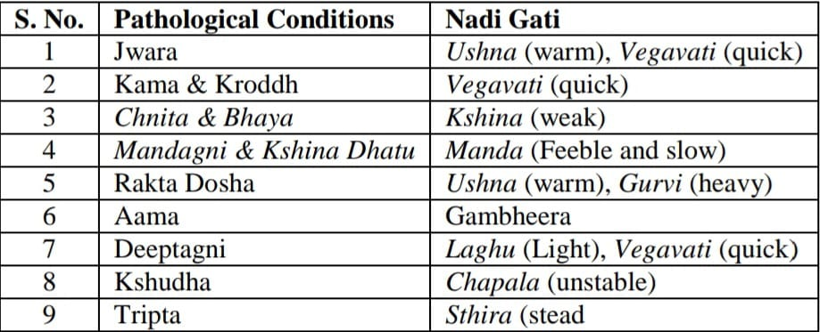
Nadi Gati According to Dosha:
Nadi Gati According to Various Pathological Conditions:

Slide 21
Prognosis According to Nadi Gati:

Slide 22
रोगेषु नाड़ीगतिः-
1. निरोग एवं सुखी मनुष्य की नाड़ी स्थिर ओर बलवती होती है।
2. अजीर्ण में नाड़ी कठिन और मन्द होती है।
3. ज्वर में उष्ण स्पर्श और वेगवती होती है। वातिक ज्वर में कठिन और वेगवती, पित्तज्वर में कठिन और अतिवेगवती तथा कफ ज्वर में मन्द वेगवती होती है।
4. अतिसार में पहले नाड़ी तेज चलती है, किन्तु निर्बलता हो जाने पर क्षीण हो जाती है।
5. संग्रहणी में नाड़ी उछलती हुई चलती है ।
6. विसूचिका में सूक्ष्म मेंढ़क की तरह उछल-उछल कर अनियमित नाड़ी चलती है। क्रमशः शिथिल होती जाती है ।

Slide 23
7. अर्श में नाड़ी स्थिर और मन्द रहती है। वातार्श में वक्रगति, पित्तार्श में मेंढ़क के समान उछलने वाली और कफार्श में पुष्ट होती है।
8. पाण्डु और कामला में रोगी की नाड़ी चंचल और तीक्ष्ण रहती है।
9. राजयक्ष्मा और कफज कास में रोग प्रबल हो जाने पर नाड़ी कम्पयुक्त, क्षीण और मन्द रहती है।
10. श्वास रोग में श्वास का दौरा उठने पर तीव्र गति और अन्य समय मन्द रहती है।
11. हिक्का में नाड़ी अस्थिर और वेगवती होती है।
12. कृमि रोग में कभी मृदु, कभी तीव्र, कभी अतिवेगवती और कभी लुप्त प्रतीत होती है।

Slide 24
Interpretation of Nadi Pariksha for Disease:
Increase in Vaat Naadi | Rise in Pitt Naadi | High levels of Kaph Naadi
recurrent headaches | headaches | respiratory and urinary issues
joint discomfort | insomnia | Physical and mental fatigue
arthritis | dizziness | a sweet taste in the tongue
a lack of appetite | mental illness | a chilly sensation
incontinence | Eye and urine yellowing | loss of appetite
dizziness, imbalance | fever | flatulence
fever | indigestion | a cough with mucus production
vocal changes | thirst | difficulty in breathing
hoarse cough, and skin discoloration | dry lips, diarrhoea, and disorientation

Slide 25
METHOD OF EXAMINATION:
Arterial pulse is examined by observing its following aspects/parameters of pulse:
Rate
Rhythm
Volume (Amplitude)
Synchronicity/similarity on both sides
Character
Condition of the vessel wall
Radiofemoral delay
Presence of other peripheral arterial pulses.
Usually radial artery is palpated for arterial pulse examination because it is easily accessible and it lies over the hard surface (lower end of head of radius bone).

Slide 26
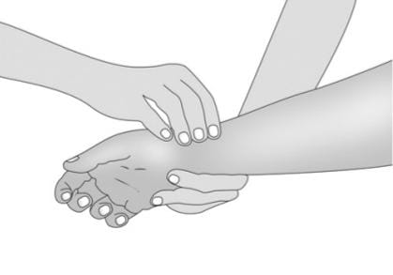
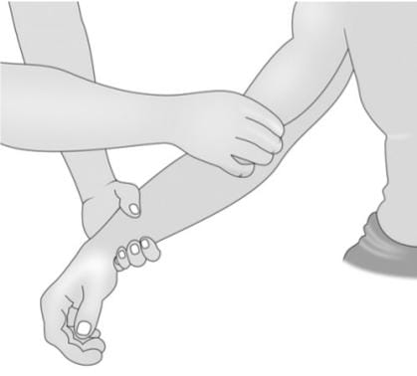
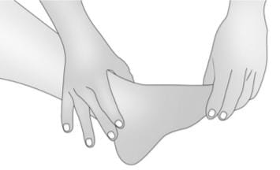
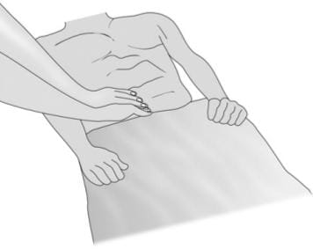
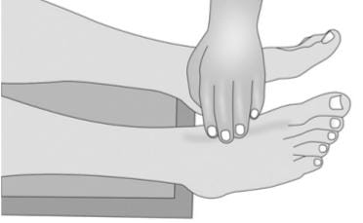
3. Brachial Pulse
1. Radial Pulse
6. Popliteal pulse
4. Posterior tibial pulse
7. Abdominal Aorta
2. Femoral Pulse
5. Dorsalis pedis pulse

Slide 27
SIGNIFICANCE OF PULSE EXAMINATION:
Much valuable information can be gained from examination of the peripheral pulses in addition to the status of the arterial system itself.
Variations in the rate, rhythmicity, intensity, and contour of the pulse wave may yield insight into a variety of disease states.
The rapid, thready pulse of hypovolemic shock is a well-known clinical sign, as is the rapid, snapping pulse characteristic of thyrotoxicosis, and the collapsing, “water-hammer” pulse of aortic insufficiency.
Different aspects of pulse examination provide clue to various physiological and pathological conditions.

Slide 28
HIGHER PULSE RATE/HEART RATE IS PRESENT:
LOWER PULSE RATE/HEART
RATE IS PRESENT:
PHYSIOLOGICAL CONDITIONS: | PATHOLOGICAL CONDITIONS:
In pregnancy | Fever
Infancy and Childhood | Anaemia
In high temperature | Thyrotoxicosis
In females, pulse rate is slightly higher (5/min as compared to males). | Paroxysmal Atrial Tachycardia
After exercise and eating. | Atrial flutter and fibrillation.
During emotions like anger, excitement. | Circulatory Shock.
PHYSIOLOGICAL CONDITIONS | PATHOLOGICAL CONDITIONS
Old age | Myxoedema
During deep expiration | Brain tumors
In athletes; because of their increased vagal tone | Heart block
In emotions like grief | Some drugs like Propranolol and Digitalis decrease heart rate.
During sleep and meditation. | Obstructive jaundice.

Slide 29
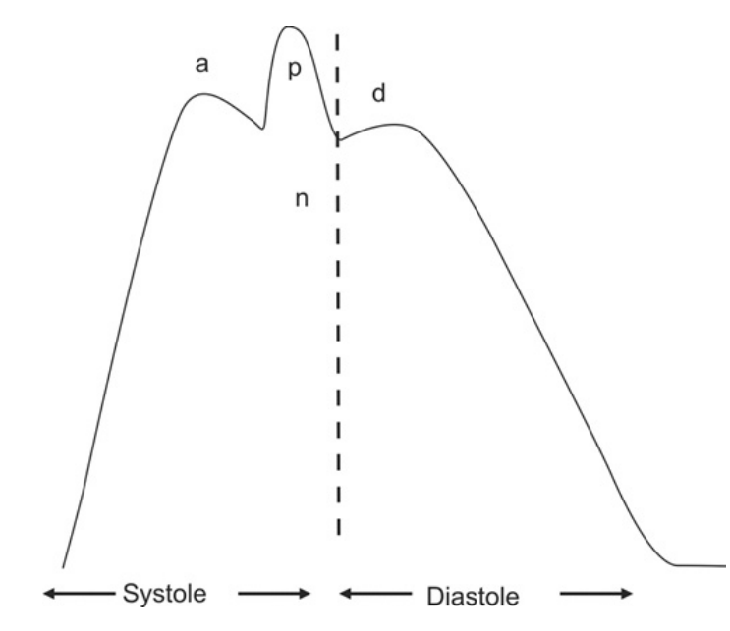
WAVES OF PULSE :
Normal radial pulse when recorded has following waves:
Waves of radial pulse; p—percussion wave, n—dicrotic notch, d—dicrotic wave

Slide 30
The ‘p’ wave: It is called percussion/tidal wave occurs due to ejection of blood from ventricles during systole.
The ‘n’ notch: It is present in the descending limb of pulse tracing and represents the closure of aortic valve.
The ‘d’ wave: It is called dicrotic wave. It occurs due to rebound of blood against the closed aortic valve during diastole.
The ‘a’ wave: It is called anacrotic wave. It is sometimes seen in the upstroke of the pulse wave. It occurs due to change in velocity of ejection of blood from ventricle towards late systole.

Slide 31
Depending on any change in the normal wave forms; various types of abnormal pulses are described. Different types of abnormal pulses are:
ANACROTIC PULSE/SLOW RISING PULSE
DICROTIC PULSE/TWICE BEATING PULSE
WATER HAMMER PULSE/COLLAPSING OR CORRIGAN'S PULSE
PULSUS ALTERNANS
PULSUS BISFERIENS
PULSUS PARADOXUS

Slide 32
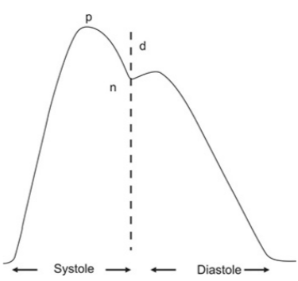
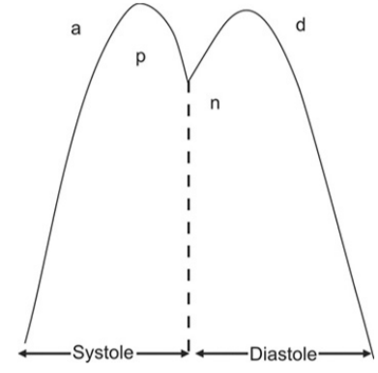
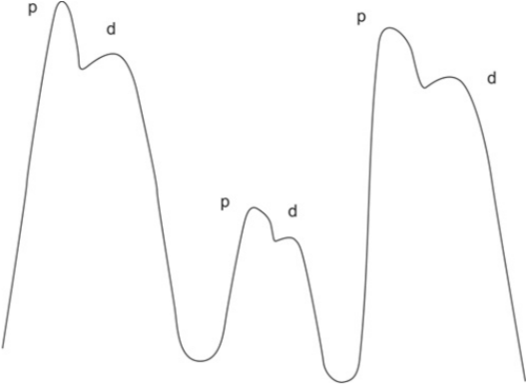
ANACROTIC PULSE/SLOW RISING PULSE :
It has two upstrokes. A secondary wave occurs in the upstroke of the pulse. The pulse wave is slow to rise and occurs when the ventricular ejection is prolonged. Usually it is seen in aortic stenosis.
DICROTIC PULSE/TWICE BEATING PULSE
A dicrotic pulse results from the accentuated diastolic dicrotic wave that follows the dicrotic notch. It is called ‘Twice beating pulse” because the dicrotic wave is prominent and gives impression of 2 beats. It is present in fever.
PULSUS ALTERNANS
Pulsus alternans is a variation in pulse amplitude occurring with alternate beats due to changing systolic pressure. Pulse is regular but alternate beats are strong and weak. It is best appreciated by applying light pressure on the peripheral arterial pulse, and can be confirmed by measuring the blood pressure. Ex. Left ventricular failure.

Slide 33
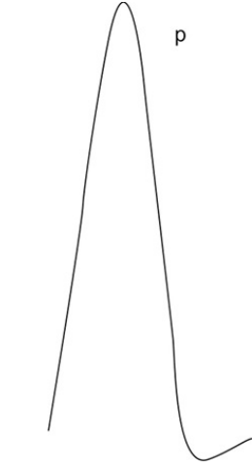
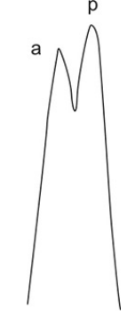
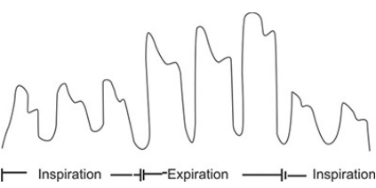
WATER HAMMER PULSE/COLLAPSING OR CORRIGAN'S PULSE
The Corrigan or water-hammer pulse is characterized by an abrupt, very rapid upstroke of the peripheral pulse (percussion wave), followed by rapid collapse. Dicrotic notch is usually absent. It is best appreciated by raising the arm abruptly and feeling for the characteristics in the radial pulse. It probably results from very rapid ejection of a large left ventricular stroke volume into a low resistance arterial system. Ex. Fever, Chronic Alcoholism.
PULSUS PARADOXUS
There is an accentuation of normal phenomenon of decrease in pulse volume with inspiration. When there is a more marked inspiratory decrease in arterial pressure exceeding 20 mm Hg, the pulse is termed Pulsus paradoxus. In contrast to the normal situation; this can be easily detected on palpation. Ex. Asthma, Emphysema.
PULSUS BISFERIENS
It is a combination of the low raising pulse (anacrotic) and the collapsing pulse. This is typically seen in aortic stenosis associated with aortic incompetence.

Slide 34
OTHER PERIPHERAL PULSES:
In absence of any pathology, all peripheral pulses are well felt and appear simultaneously on both sides.
Peripheral pulses may not be felt properly in peripheral vascular disease.
Reduced or absent arterial pulses are a sign of impaired blood flow.
Palpation of peripheral pulses is important in diagnosis of various diseases like:
Congenital abnormalities (coarctation of the aorta, anomalous peripheral arteries)
Intrinsic arterial disease (atherosclerosis, thrombosis, arteritis)
Vasospastic disorders (Raynaud's phenomenon)
Involvement of the vessel by extrinsic compression (thoracic outlet syndrome, trauma, neoplasms).

Slide 35
Conclusion:
Nadi Pariksha allows us to learn about our Doshas and the future so that our physicians may make informed decisions about how to treat us. Nadi Vigyana allows a physician to detect early warning signals of sickness.
Nadi can determine the stage of pathogenesis by pinpointing the organ tissue and Dosh involved. A disease's Origin may be traced back to a certain Dosha or Dhatus.
We are drawn to this ancient practice as we re-examine its role as the primary diagnostic tool for a variety of ailments.
Nadi was the primary diagnostic tool utilised when modern laboratories were unavailable many thousand years ago.
We may need to make a temporary adjustment to this method now that our facilities have been renovated. When it comes to evaluating Rog and Rogi Bala, Ashatasthana Pariksha is a crucial instrument. According to the aforementioned studies, Nadi Pariksha is an effective method for diagnosing illness and predicting its consequences for the body.

Slide 36
2. मूत्र परीक्षा :
निशान्त्ययामे घटिकाचतुष्टये उत्थाप्य वैद्यः किल रोगिणं च ।
मूत्रं घृतं काचमये च पात्रे सूर्योदये तत्सततं परीक्षेत् ।।
(योगरत्नाकर 10)
तस्याऽऽद्यधारां परिहृत्य मध्यधारोद्भवं तत्परि धारयित्वा सम्यक्परिज्ञाय गदस्य हेतुं कुर्याच्चिकित्सां सततं हिताय ।
(योगरत्नाकर 10)

Slide 37
योगरत्नाकर द्वारा वर्णित मूत्र की तेल बिन्दु परीक्षा:
Oil Position in Different Disease Condition:
Prognosis According to Taila Bindu Pariksha:

Slide 38
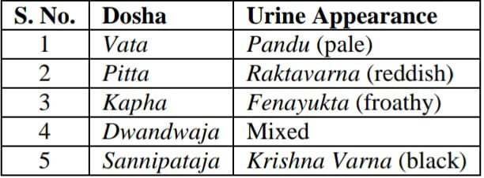
Taila Bindu Appearance in Different Dosha Vikar :
Mutra Lakshana According to Dosha:

Slide 39
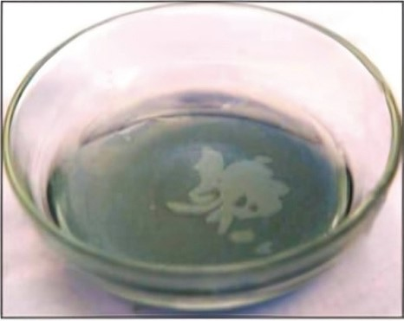
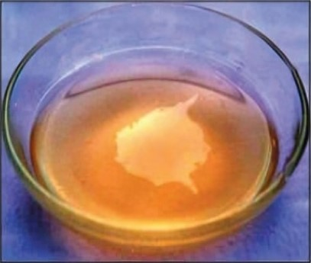
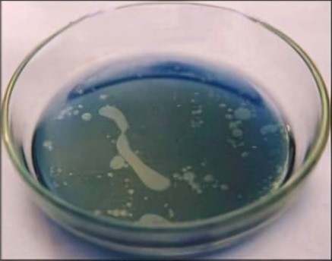
1. healthy persons- irregular shape
2. Swan shape of oil spreading in the urine sample of one of the healthy volunteers’.
3. Reddish yellow tinged urine of Kaamala patient, with demon or tiger shaped pattern of oil spread in the urine sample.
4. A urine sample of a group of patient
(curable diseases) suffering from viral fever with oil spread in shape of snake.

Slide 40
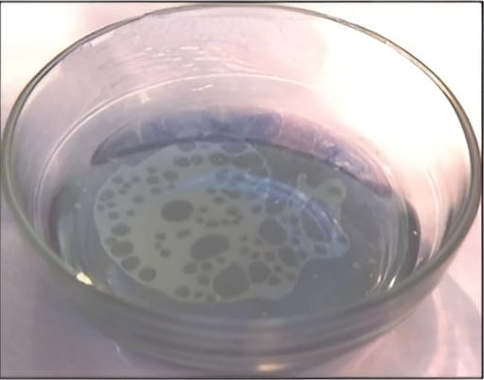
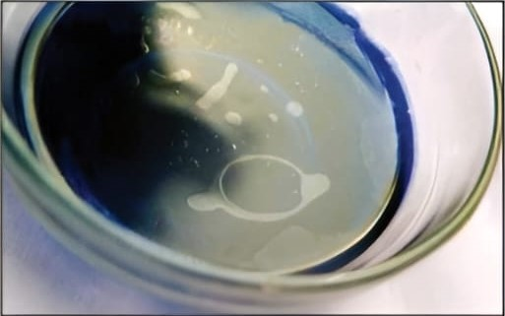
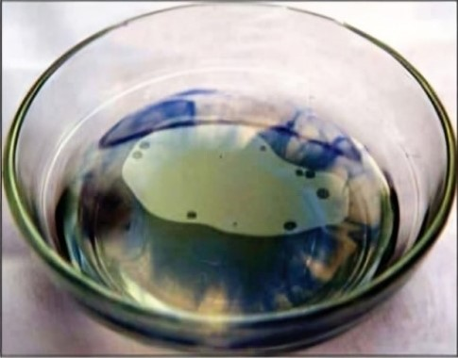
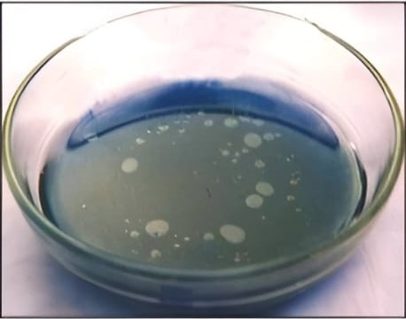
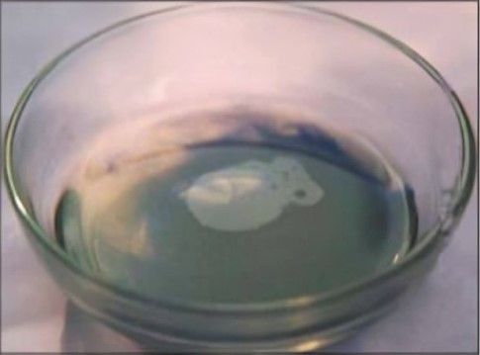
8. Sieve shape of oil spread in a Amavata (Rheumatoid arthritis) patient.
(incurable disease)
5. Budbuda (bubbles) shape of oil spread in a Viral fever patient suffering from curable diseases.
6. Ring shape oil spread in the urine sample of a patient suffering from Pandu (Anemia) and suffering from curable diseases.
9. Skull shape of oil spread in a Amavata (Rheumatoid arthritis).
7. Mukta (pearls) shape of oil spread in a patient suffering from curable diseases and suffering from Kaphaja Kasa
10. Owl bird shape of oil spread in a Madhumeha (Diabetes) patient.

Slide 41
रोगों के कारण मूत्र के वर्ण में अन्तर :
1.पाचन विकृति में पीला- लाल मूत्र निकलता है ।
2. पित्तवृद्धि से गहरा पीला मूत्र होता है ।
3. पाण्डु, कामला और पित्तविकार में हरा-पीला मूत्र आता है ।
4. मूत्रातिसार में बार-बार पानी जैसा मूत्र आता है ।
5. ताप एवं यकृद्विकार में पीले-लाल रंग का अल्पमात्रा में मूत्र होता है।
6. सगर्भा स्त्री का मूत्र स्वच्छ आता है, किन्तु उसमें रूई के रेशे के समान परमाणु दिखते हैं।
7. हृदय की दुर्बलता और मूत्राशय शूल में मांस धोवन के समान वर्ण का मूत्र होता है।

Slide 42
The Composition of Urine:
Normal Urine Constituents | Abnormal Urine Constituents
Water (about 95% of urine) | Glucose
Urea | Protein
Creatinine | Bile pigments
Uric acid | Blood cells
Electrolytes | Cast parasites and Bacterial microbes
Types of Specimen :
First Morning Specimen
Random Specimen
Second-voided Specimen
Postprandial
24-Hour specimen
Mid-stream Specimen
Clean Catch Urine Specimen

Slide 43
Type of Examination in Routine Urinalysis
Physical Examination of Urine:
Volume
Color
Odor
Appearance
pH
Specific gravity
2. Chemical Examination of Urine:
Glucose
Protein
Ketones
Bilirubin
Urobilinogen
Blood
Nitrite
Leukocyte Esterase
3. Microscopic Examination of Urine:
RBCs
WBCs
Epithelial cells
Casts
Bacteria
Yeasts
Parasites
Crystals
Artifacts

Slide 44
Physical Examination Of Urine
Urine volume: This is dependent normally up on fluid intake, environmental condition, diet and activity of the human.
Normal value (1.5 L/Day)
Above normal (Polyuria) urine volume (<2.5-3L/Day)
Under normal (Oligourea) urine volume (<400 ml/Day)
Color: Can be observed in a test tube or in a urinometer tube
Yellow to amber (Normal)
Colorless to pale yellow
Dark yellow or yellow brown
Yellow brown or greenish yellow
Appearance (Transparency): Fresh voided urine specimen is normally clear and transparent.
PH: Average is pH 6.
Specific Gravity of Urine: Normal value 1.010- 1.030.

Slide 45
Chemical Analysis Of Urine:
Dipstick chemical analysis:
Urine dipstick is a narrow plastic strip which has several squares of different colors attached to it.
Each small square represents a component of the test used to interpret urinalysis.
Colors generated by each pad are visually compared against a range of colors on brand-specific color charts.
The entire strip is dipped in the urine sample and color changes in each square are noted.

Slide 46
Key elements of urine dipstick test:
Investigation | Comment
Glucose | Small amounts may be excreted by normal kidneys. Glycosuria may indicate poorly controlled diabetes mellitus.
Protein | Varies between trace and 4+. The greater the degree of proteinuria, the more likely there is to be significant renal disease.
Ketones | Ketonuria occurs in diabetic ketoacidosis, starvation, alcohol use and very-low-carbohydrate diets.
Bilirubin and urobilinogen | Bilirubin is not normally present. Urobilinogen may be up to 33 µmol/L in health. Abnormalities of bilirubin and urobilinogen require investigation for possible hemolysis or hepatobiliary disease
Blood | The urine normally contains a small amount of haemoglobin which does not show up on the test, but a higher amount (haemoglobinuria) will show up as a positive test result.
Nitrite | Most Gram-negative bacteria convert urinary nitrate to nitrite. A positive result indicates bacteriuria but a negative result does not exclude its presence
Leucocyte esterase | Indicates the presence of neutrophils in urine. Seen in urinary tract infection or inflammation, stone disease and urothelial cancers.

Slide 47
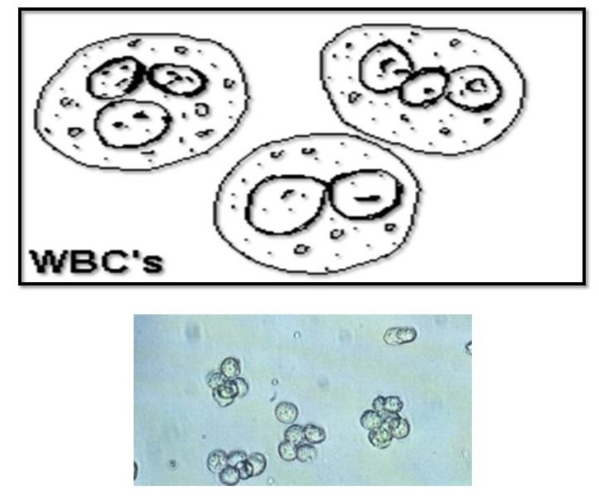
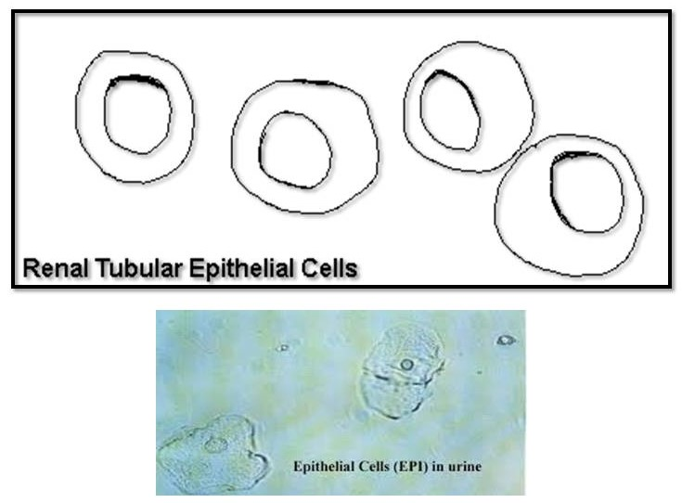
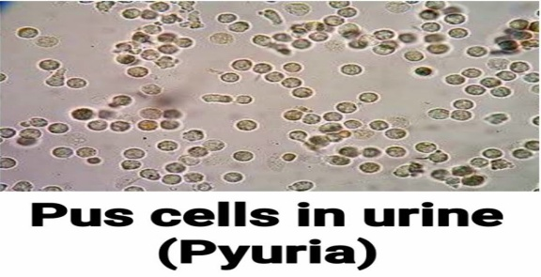
MICROSCOPIC URINALYSIS
Microscopic examination used to view elements that are not visible without microscope.
RBCs: Hematuria is the presence of abnormal numbers of red cells in urine. It is of 2 types: Gross hematuria and Microscopic hematuria.
2. WBCs: WBCs (pus) in the urine may be caused by a UTI, bladder tumor, inflammation of the kidneys, lupus, or inflammation of the genitals.
3. Epithelial Cells: Renal tubular epithelial cells, contain a large round or oval nucleus and normally slough into the urine in small numbers.

Slide 48
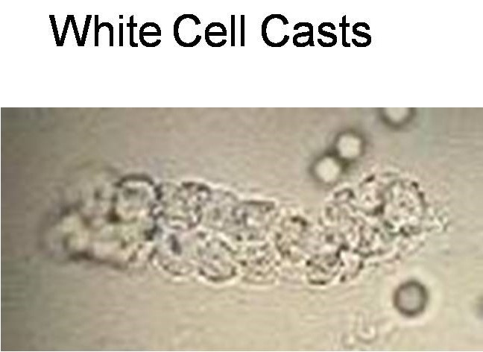
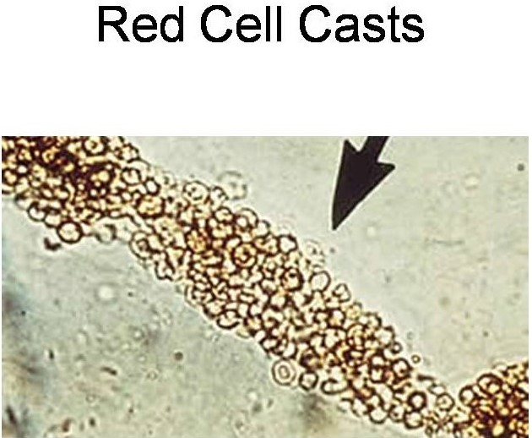
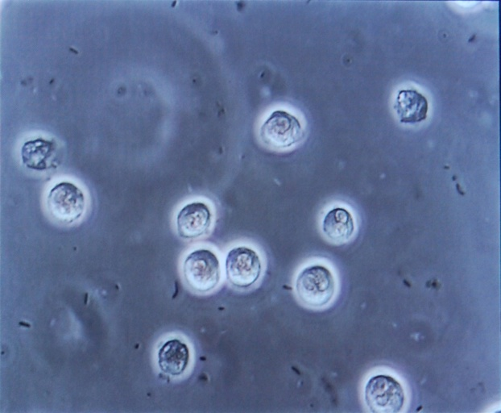
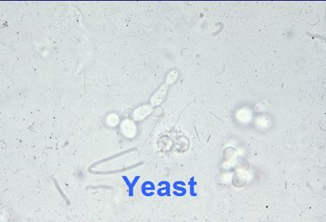
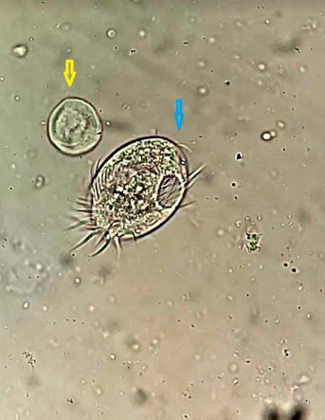
4. Cast Cells: Can indicate kidney inflammation or damage, metal poisoning (such as lead or mercury), heart failure, or a bacterial infection.
5. Bacteria, Yeast, Parasite:
Any can indicate a UTI.
Bacteria in urine.
Yeast in urine.
Parasite in urine.

Slide 49
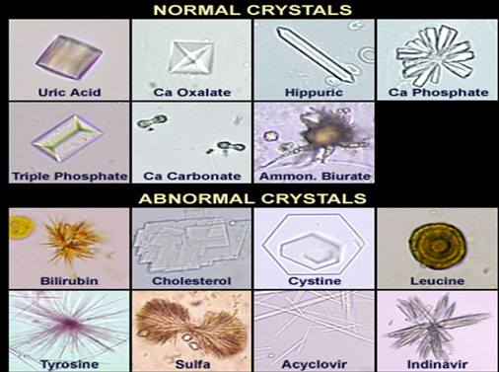
6. Crystals: Large amounts of crystals, or types of crystals, can indicate kidney stones, kidney damage, or problems with metabolism. Some medications or types of urinary tract infections can increase the number of crystals in urine.

Slide 50
3. मल परीक्षा :
भौतिक परीक्षा से मल की मात्रा, रंग, घनता, द्रवता, आकार और गन्ध का निर्णय किया जाता है।
रोगेषु मलस्थितिः-
1. वायु विकार से मल झागदार, शुष्क और धूम वर्ण का होता है।
2. पित्त विकार से पीला, दुर्गन्धयुक्त, उष्ण और द्रव मल होता है।
3. कफ से सफेद, स्निग्ध और बँधा मल होता है।
4. द्वन्द्वज विकार से दो दोषों के लक्षण वाला मल होता है।
5. सन्निपातज विकार में सफेद या काला-पीला, पतला और गाँठ वाला मल हो जाता है।

Slide 51
6. वातज्वर में मलावरोध होकर मल शुष्क और काला हो जाता है। पित्त ज्वर में पतला और पीला, कफ ज्वर में सफेद, चिकना और जीर्ण ज्वर में मल थोड़ा शुष्क, थोड़ा पतला और धूसर वर्ण का होता है।
7. अजीर्ण वालों का दुर्गन्धयुक्त और ढीला मल होता है।
8. विसूचिका में मल चावल के धोवन के समान सफेद रंग का और जल जैसा पतला होता है ।
9. पित्तावरोधजन्य कामला में तिलपिष्ट सदृश अतिदुर्गन्धयुक्त मल निकलता है।
10. आमाशय अथवा लघु आन्त्र में से रक्तस्राव होने पर मल रक्तमिश्रित दुर्गन्धयुक्त काले रंग का हो जाता है।
11. आन्त्र विद्रधि पककर फूटने के बाद पूयमिश्रित मल निकलता है।

Slide 52
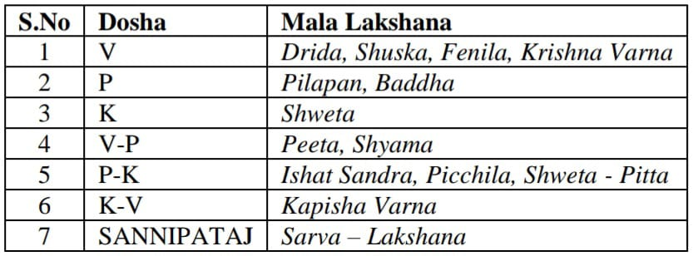
Lakshana of Mala According to Dosha :
Mala Swaroop in various diseases :

Slide 53
मल में लाल रंग आने के कारण :
1. अर्श
2. गुदविदार ( गुदभेद ) में अतिकष्ट होता है।
3. गुदा पर व्रण
4. बालकों की गुदनलिका में अर्बुद
5. अधोग रक्तपित्त
उक्त कारणों से लाल रंग का रक्त मल के साथ आता है ।

Slide 54
How to take stool samples:
1. Specimen of stool (at least 4 ml or 4 cm³) is collected in a clean, dry, container with a tightly fitting lid.
2. Do not let sample stand for a long period of time.
3 Early morning is the best time for taking sample.
4. For children prefer to urinate first before taking a stool sample.
5. Stool should not be contaminated with urine, water, soil, or menstrual blood.
6. Patient's name, date, time & number must be labeled on the sample container.
7. Stools should be examined as early as possible after receipt in the laboratory(preferably within 1 hour of collection).
8. Patient must not use laxatives prior collecting stool sample.
9. Patient must refrain from taking certain medicines before the test such as: pH medications, diarrhea medications, anti - parasite drugs, antibiotics.
10. The patient must wear gloves before handling a stool sample in order to avoid transmission and don't take a stool sample base of the bathroom (toilet) floor.
11. The patient must wash his hands thoroughly after taking the sample. And the sample water or soap does not mix.

Slide 55
STOOL EXAMINATION :
General Stool Examination (GSE) is carried out in laboratories for various diagnostic purposes. Examination of stool is very helpful in the diagnosis of disease of the gastrointestinal tract. It consist the following tests:
1. Physical Examination
2. Microscopic Examination
3. Chemical Examination
4. Stool Culture.

Slide 56
Stool Culturing
1) Culture media:
MacConkys Agar: inhibits most of the gram positive organisms, differentiate between lactose fermenters and non lactose fermenters.
Xylose lysine deoxycholate (XLD) agar: This selective medium has been recommended for the isolation of Salmonella and particularly Shigella from fecal samples
Thiosulphate citrate bile salt sucrose (TCBS) agar: This is an excellent, selective medium for the primary isolation of Cholerae.
Sorbitol MacConkys agar: This MacConkys agar contains sorbitol instead of lactose. E.coli 0157 produces colorless colonies on this medium because it does not ferment sorbitol so; this medium is useful for screening 0157 E.coli.
2) Culturing of sample: Stool cultured on selective media by streaking a loop full of stool specimen, the stool macroscopic examination may aid in selecting the suitable culture media. After the identification of the microbe the antibiogram should be done.

Slide 57
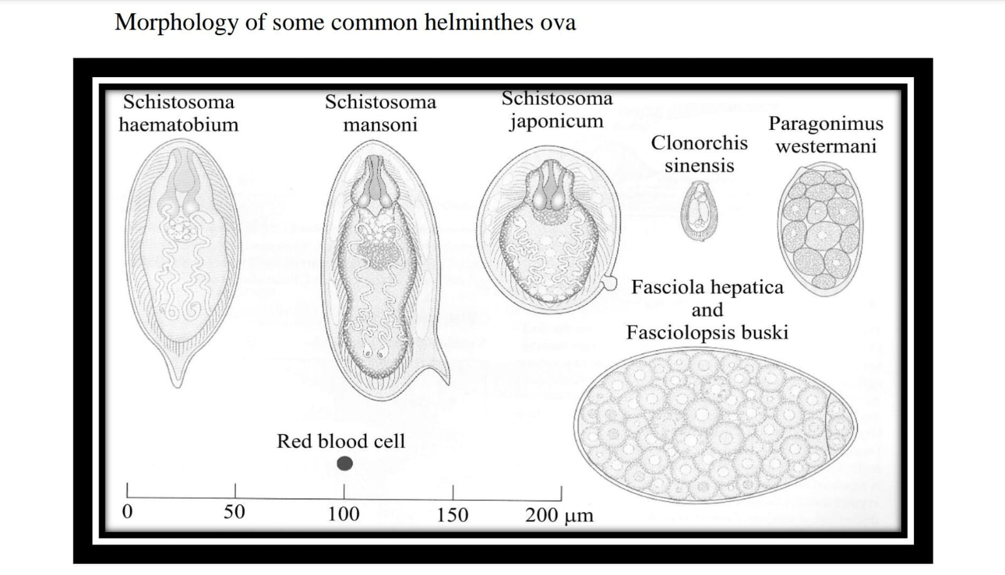
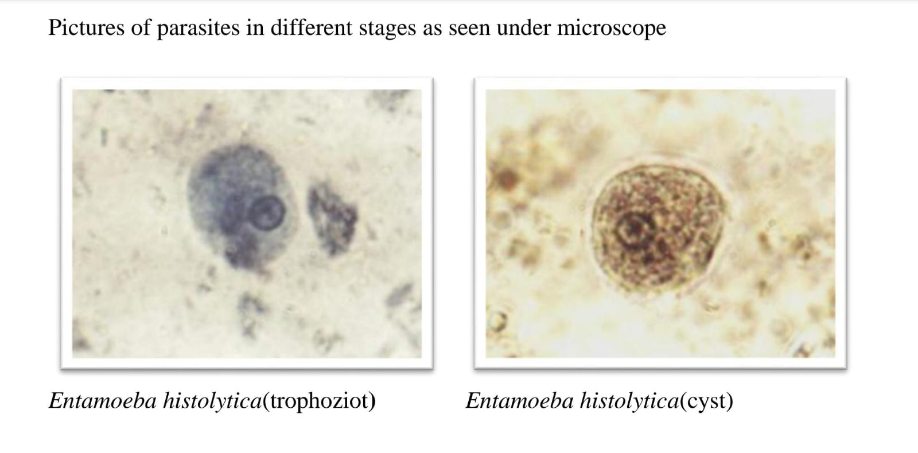
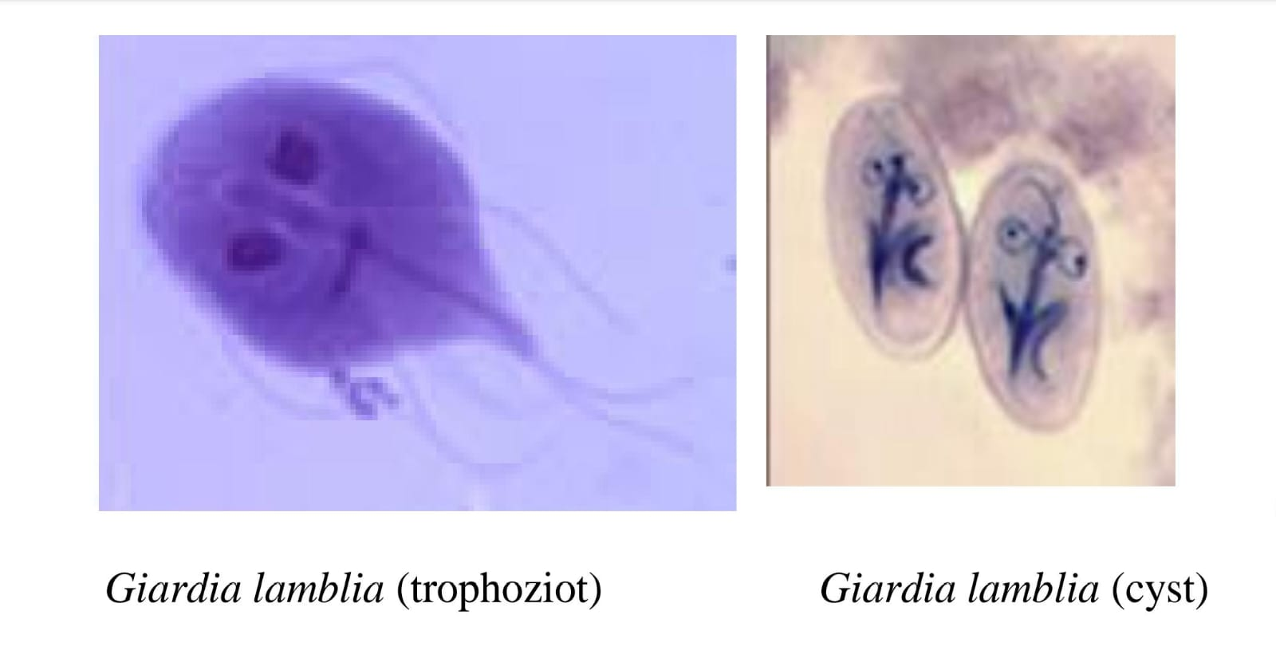
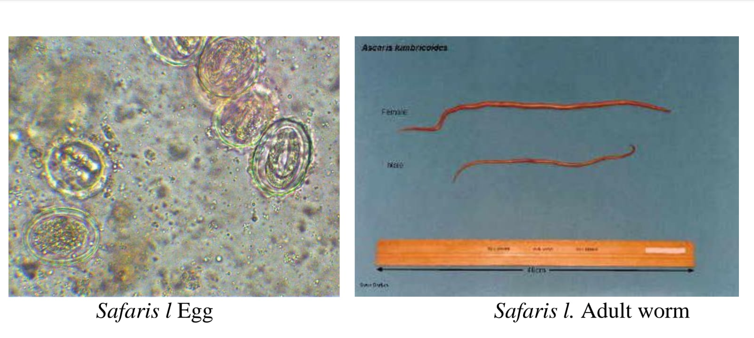
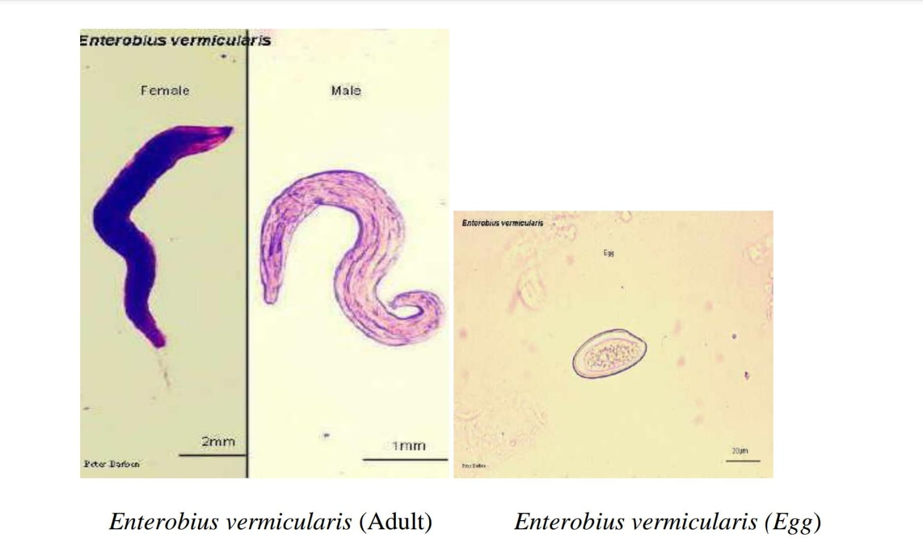

Slide 58
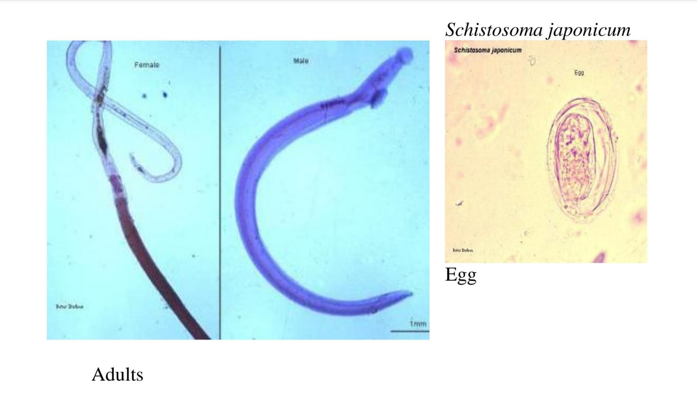
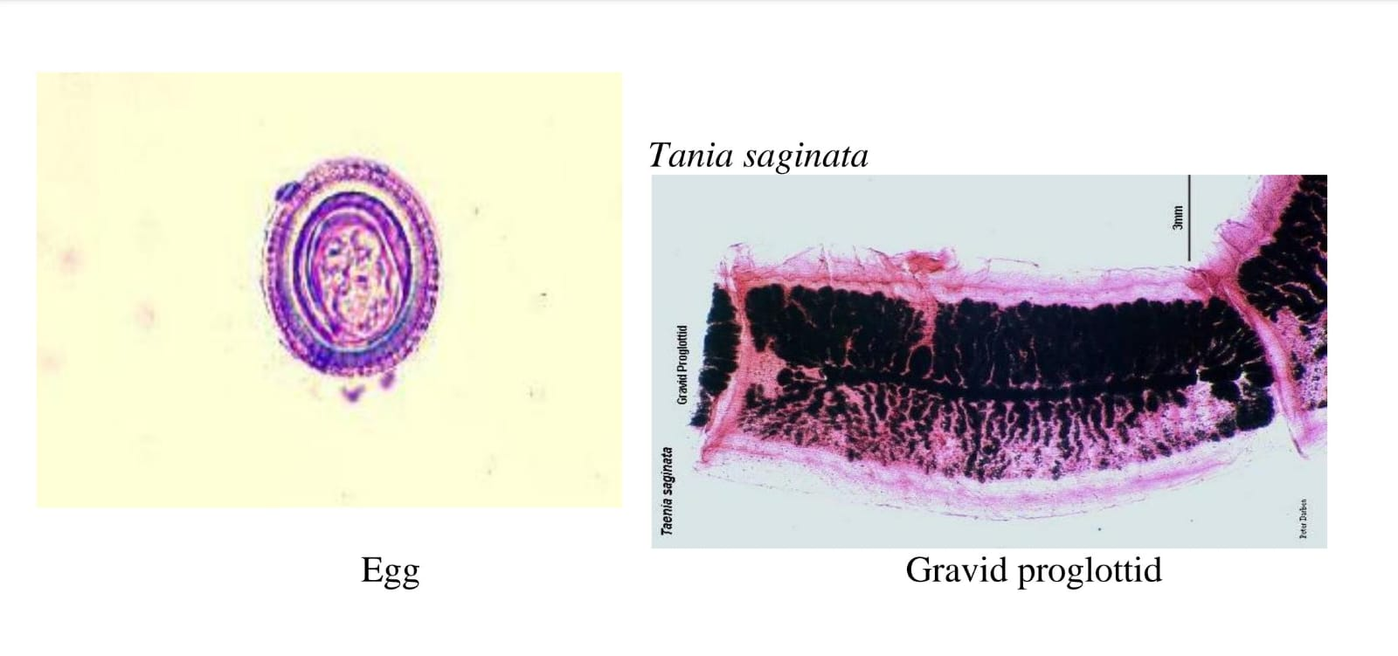
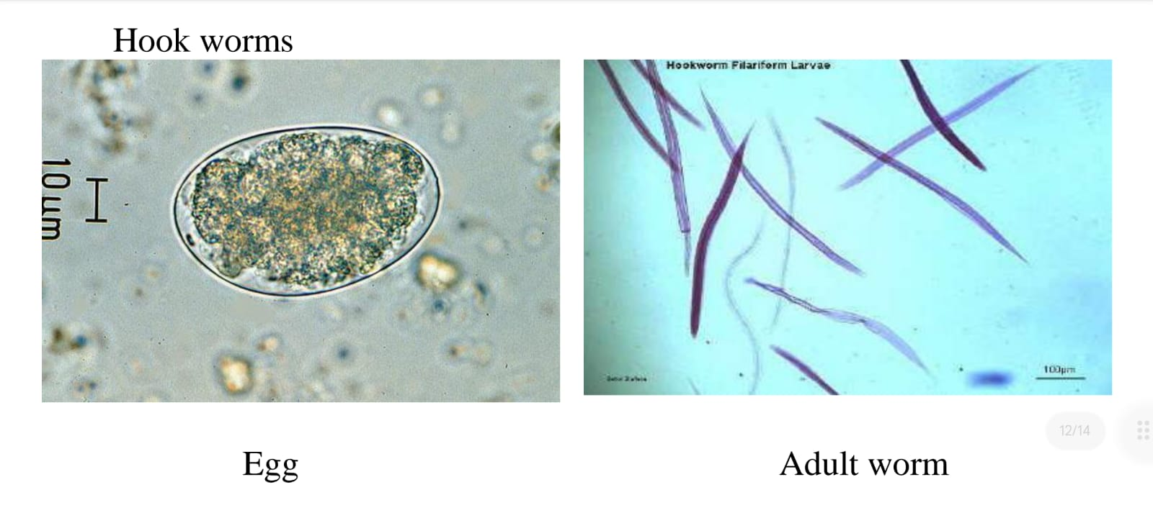
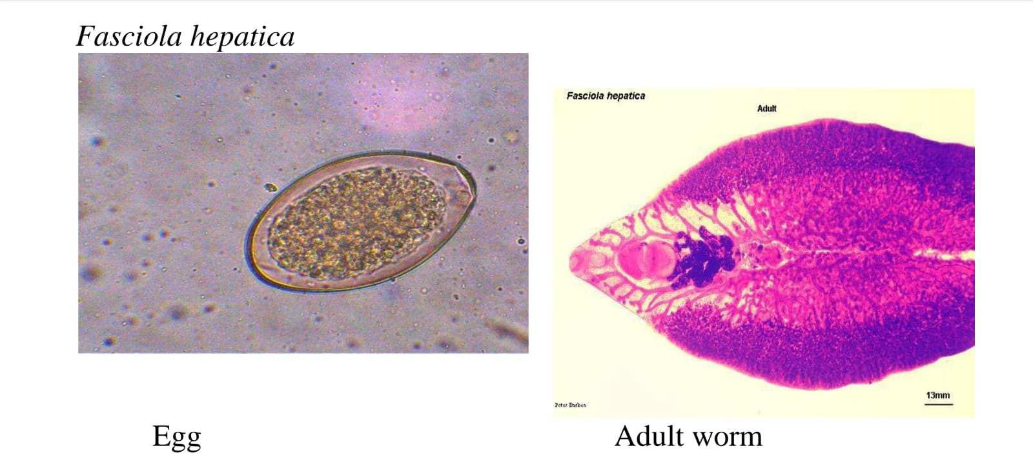
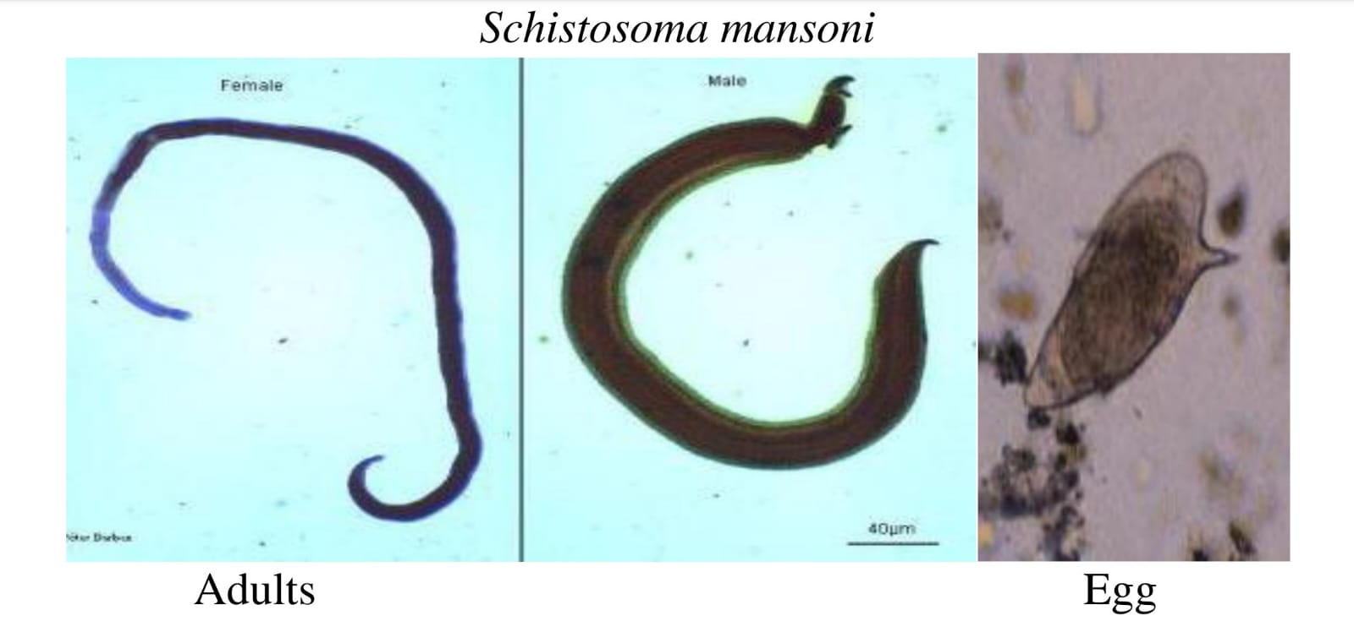
(Ancylostoma duodenale)

Slide 59
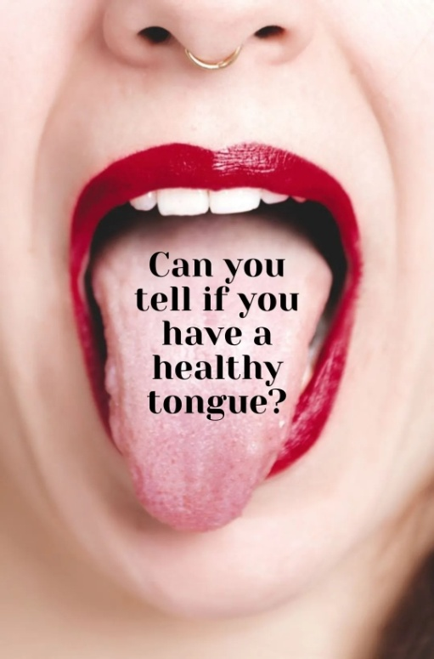
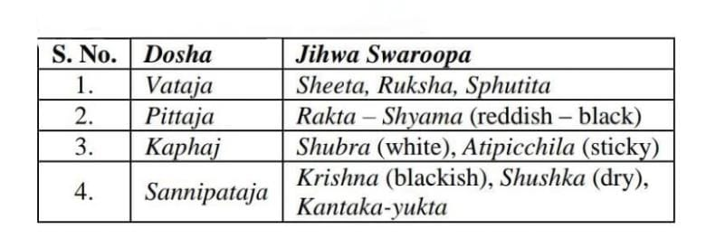
जिह्वा परीक्षा
जिह्वा के निरीक्षण से कण्ठ, आमाशय एवं आन्त्र की स्थिति तथा कतिपय रोगों के बारे में उपयोगी सूचना मिलती है। स्वस्थ मनुष्य की जिह्वा गीली, स्वच्छ और अग्रिम भाग में लाल होती है। रोगों में यह स्थिति परिवर्तित हो जाती है।
जिह्वा शीता खरस्पर्शा स्फुटिता मारुतेऽधिके ।
रक्ता श्यामा भवेत्पित्ते कफे शुभ्राऽतिपिच्छिला।।
कृष्णा सकण्टका शुष्का संनिपाताधिके तु सा।।
(योगरत्नाकर 15 )

Slide 60
Conditions of Jihvā in various disorders :
असित जिह्वा (Asita jihvā) Blackish tongue | मदात्यय असाध्य लक्षण (Madātyaya asādhya laksana)
जिह्वा लेप (Jihva lepa) Coated tongue | अम्लपित्त (Amlapitta)
नील जिह्वा (Nīla jihvā) Bluish tongue | मदात्यय असाध्य लक्षण (Madātyaya asādhya laksana)
जिह्वा निष्कर्ण्य (Jihvā niskarsya) Prolapsed tongue | तृष्णा निरोधज दाह (Trşņā nirodhaja dāha)
जिह्वा शोष (Jihva soșa) Dryness of tongue | तृष्णा निरोधज दाह (Trşņā nirodhaja dāha)
जिह्वा स्तम्भ (Jihvā stambha) Stiffened tongue | जिह्वास्तम्भ (Jihvāstamba)
जिह्वा उपदेह (Jihvāupadeha) Coated tongue | प्रमेह पूर्वरूप (Prameha pūrvarupa)
जिह्वा वेपन (Jihvā vepana) Tongue tremor | तृष्णानिरोधज दाह (Trsnānirodhaja dāha)

Slide 61
TECHNIQUE OF THE TONGUE EXAMINATION:
On physical examination, there are several characteristics of the tongue that should be noted:
Color: Pink (Shyavarakta) - red on dorsal and ventral surfaces. The ventral surface may have some visible vasculature.
Texture: Rough dorsal surface owing to papillae, which have three types. There should be no hairs, furrows, or ulceration.
Size: Should fit comfortably in mouth, tip against lower incisors. Sublingual glands should not be displaced.
Shape: Tanu (Neither too thick nor too thin and has even width or oval in shape)
Moisture: Slakshna (A healthy tongue is moist)
Coating: Nirlipta or ishathlipta (Thin transparent or white coating)
Movement: Akampa (when sticking out it is straight rather than veering to one side)

Slide 62
In general, the examination of the tongue should occur in the following steps:
1. Have the patient touch the tip of the tongue to the roof of their mouth and inspect the ventral surface.
2. Have the patient protrude the tongue straight out and inspect for deviation, color, texture, and masses.
3. With gloved hands, hold the tongue with gauze in one hand while palpating the tongue between the thumb and index finger of the other, noting masses and areas of tenderness.

Slide 63
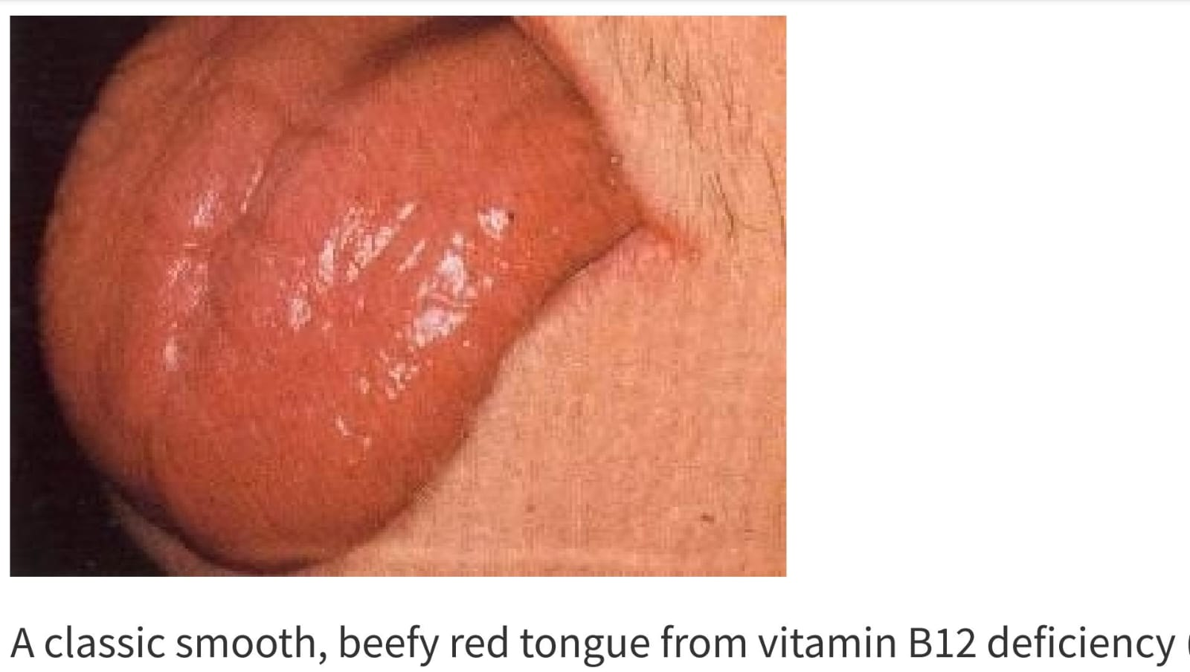
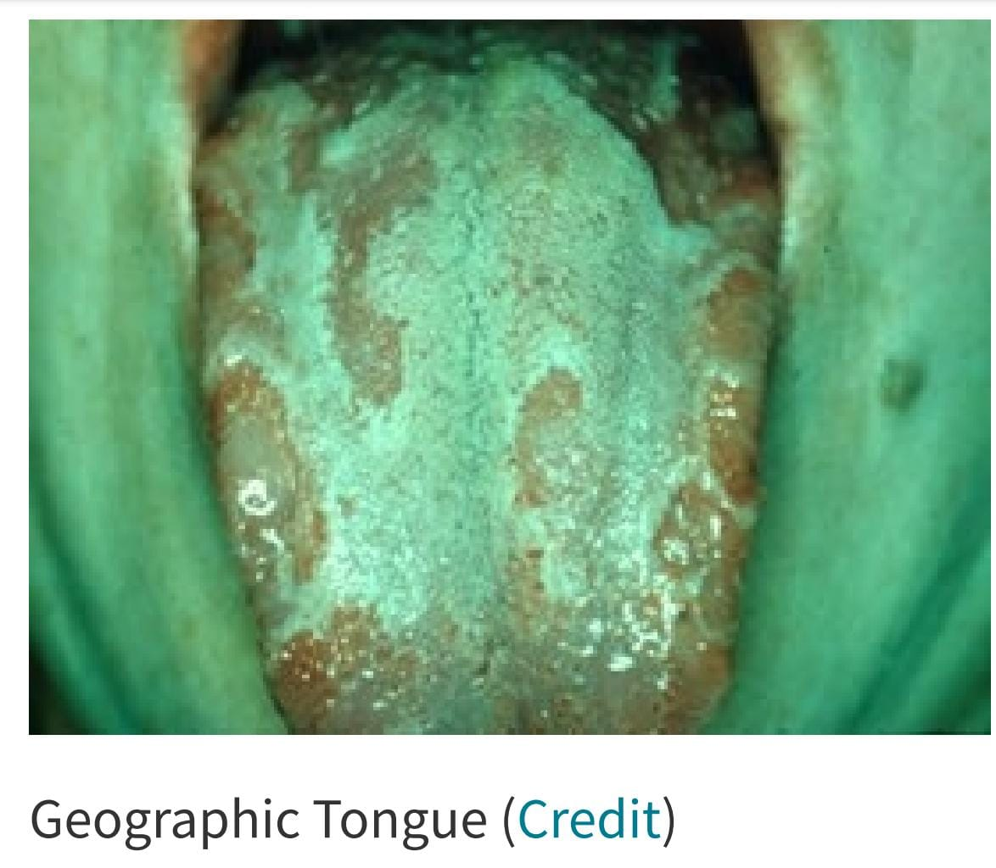
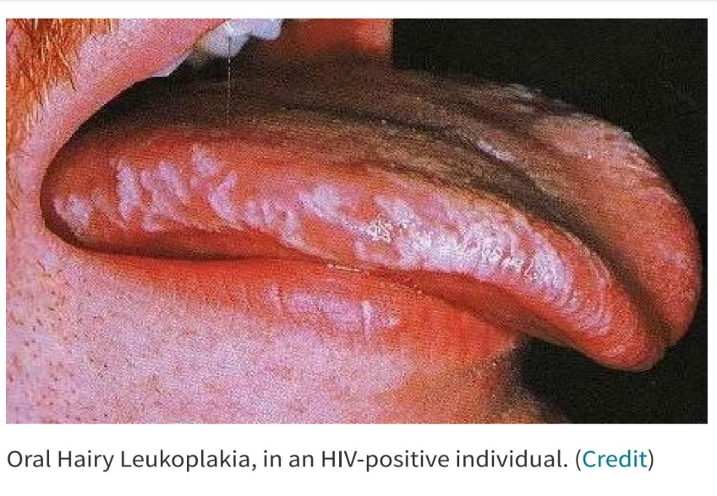
Clinical Findings in Tongue Pathology:
Geographic Tongue:
Geographic tongue is a benign condition in which discolored, painless patches of the tongue appear and then reappear from atrophy, often in a different distribution. This is seen in 1-3% of the population.
Hairy tongue:
White hairs along the sides of the tongue are the classic appearance of oral hairy leukoplakia, the result of EBV infection in HIV-positive individuals.
Smooth Tongue:
The most common cause of a smooth tongue is the use of dentures.
Nutritional deficiencies include iron, folate and vitamin B12 deficiency.

Slide 64
PINK
BLACK
WHITE
PURPLE
RED
GREY
YELLOW
ORANGE
GREEN
BLUE

Slide 65
CONCLUSION:
Tongue is a reflection of what is happening inside the body.
Along with other examination of Astasthana parikshana and Lakshana (Symptoms), the tongue examination is an easy and indispensable part to know Sama, nirama and Vruddi, kshaya avastha of the dosha, finally in the Sapekshanidana (diagnosis)of the disease.
So one should examine the tongue very carefully and thoroughly.

Slide 66
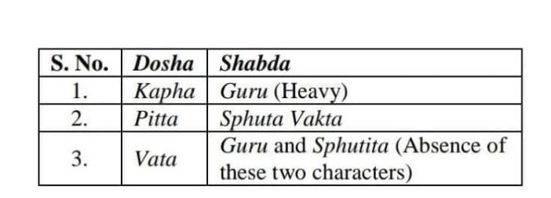
5. शब्द परीक्षा :
गुरुस्वरे भवेश्लेष्मा स्फुटवक्ता च पित्तलः ।
उभाभ्यां रहितो वातः स्वरतश्चैव लक्षयेत् ।।
( योगरत्नाकर 13 )

Slide 67
शरीर के अवयवों में होने वाले शब्दों को श्रोत्र द्वारा सुनकर परीक्षा की जाती है।
जैसे –
आन्त्रों में अव्यक्त कूजन, आटोप ( गुड़गुड़ाहट आदि),
वातरक्त में सन्धियों और पर्वो का स्फुटन,
सन्निपात ज्वर में कण्ठकूजन इत्यादि,
कफ की अधिकता से स्वर में भारीपन,
पित्त की अधिकता से अस्पष्ट ध्वनि और
वात की अधिकता से गद्गद वाणी (हकलाकर बोलना ) आदि विकार होते हैं।

Slide 68
शब्द विकृतिः
1. वात-पित्त प्रकोप से प्रलाप बढ़ जाता है ।
2. शरीर दुर्बल होने पर बोली अस्पष्ट निकलती है।
3. कण्ठशोथ, स्वरयन्त्रशोथ प्रतिश्याय, कास, कफयुक्त श्वास, क्षय, उपदंश, अर्बुद, वातवह नाड़ियों में विकार होने से स्वर भारी और विकृत हो जाता है।
4. पक्षाघात और अर्दित में वाणी अस्पष्ट हो जाती है।
5. नासावरोध से अनुनासिक उच्चारण होता है।

Slide 69
6. स्पर्श परीक्षा :
स्पर्श-परीक्षा का अभिप्राय स्पर्शनेन्द्रिय को स्पर्श कर की जाने वाली परीक्षा से है।
पित्त रोगी भवेदुष्णो वातरोगी च शीतलाः ।
श्लेष्मलः स भवेदाद्रः स्पर्शतश्चैव लक्षयेत् ।।
(योगरत्नाकर 13 )

Slide 70
7. दृक् (नेत्र) परीक्षा :
नेत्र परीक्षा का तात्पर्य यहाँ आतुर के नेत्र की परीक्षा से है! नेत्र परीक्षा द्वारा भी कतिपय विशिष्ट व्याधियों व वातादि दोषों का ज्ञान होता है।
रूक्षा धूम्रा तथा रौद्रा चला चान्तर्ज्वलत्यपि।
दृष्टिर्यदा तदा वातरोगं रोगविदो जगुः ।।
दीपद्वेषि च सन्तप्तं पीतं पित्तेन लोचनम् ।
जलार्द्र ज्योतिषा हीनं स्निग्धं मन्दं कफेन तत् ॥
द्वन्द्वदोषे भवेन्मिश्रं तूर्णं तूर्णं विलोचनम् ।
श्यामवर्णं च निर्भुग्नं तन्द्रामोहसमन्वितम् ।।
रौद्रं च रक्तवर्णं च भवेच्चक्षुस्त्रिदोषतः ।
(योगरत्नाकर )

Slide 71
Drik Pariksha:

Slide 72
8. आकृति परीक्षा :
आकृति परीक्षा से तात्पर्य शरीर के स्थूल भावों की आकारिकी परीक्षा से है। इसके अन्तर्गत समान्यतः चक्षु द्वारा देखे जाने वाले सभी स्थूल भावों का समावेश होता है।
यथा- मुख की आकृति, अंग-प्रत्यंग का संगठन, प्रमाण, वर्णाकृति, शरीराकृति, शोथादि की आकृति, गुल्म, अर्बुद, व्रणादि की आकृति आदि।
इस प्रकार आकृति-परीक्षा के अन्तर्गत बहुत से भावों का समावेश होता है।
कतिपय व्याधियों का विनिश्चय आकृति के आधार पर किया जाता है।

Slide 73
आकृति परीक्षा (Akriti Parīkṣā)
आक्षेप (Aksepa) Convulsion | आक्षेपक (Aksepaka) अपस्मार (Apasmāra) अपतन्त्रक (Apatantraka) धनुस्तम्भ (Dhanustambha) वातव्याधि (Vātavyādhi)
अंगुलि वक्रता (Anguli vakratā) Curved finger | वातरक्त असाध्य लक्षण (Vātarakta asādhya laksana)
आसीनोलभते सौख्यम् (ĀsinolabhateSaukhyam) Comfort on sitting posture | तमकश्वास (Tamaka Śvāsa)
अवाध्मायते (Avadhmāyate)Change of posture intermittently | तमकश्वास (Tamaka śvāsa)
आयाम्यते देह (Ayāmyate deha)Stretching of body | हिक्का असाध्य लक्षण (Hikkā asādhya laksana) स्नायुगत वात (Snāyugata vāta)
बलक्षय (Balakşaya)Loss of strength | अस्थिगत वात (Asthigata vāta) ग्रहणिदोष पूर्वरूप (Grahani doșa pūrvarupa) हलिमक (Halimaka) जराशोष (Jarā śoșa

Slide 74
CONCLUSION:
Before starting the treatment of any disease, diagnosis is the first and most important step.
To diagnose various diseases, Ashtavidha Pariksha is mentioned as a necessary tool in our different Ayurvedic texts.
On the basis of eight factors mentioned in Ashtavidha Pariksha, diagnosis can be conclude to a particular disease and then treatment can be done.
These got modified with the advent of time and the additions of things were done according to requirements.

Slide 75
REFERENCES:
Ashtang Hridayam (By Dr. Ram Tirth Sharma)
Charak Samhita (By Pandit Kashinath Pandey Shastri)
Yogratnakar (By Vaidya Shri Lakshmipati Shastri)
Textbook of Ayurvediya Vikriti Vijnana & Roga Vijnana ( Dr. P.S. Byadgi)
Ayurvediya Vikriti Vigyan (Dr. B.K. Dwivedi)
Ayurvediya Vikriti Vigyan (Dr. Vidyadhar Shukla)
Applied aspect of Ashtasthana Pariksha w.s.r. to tools used in current era - Neha Yadav, Amarendra Kumar Singh, JAIMS
A Review Study of Pulse in Numerous Asian Medical Systems – Sachin Kulkarni, Madhuri P Bhide, Savita Nilakhe, Bharati Vidyapeeth
CLINICAL IMPORTANCE OF ASHTAVIDHA PARIKSHA – A DIAGNOSTIC METHOD IN AYURVEDA - Dr. Seema Dhabaliya, Dr. Pravinkumar Kharadi, Dr. Devkinandan Wagh and Dr. Jasmin Gohel
A study on Tailabindu pariksha – An ancient Ayurvedic method of urine examination as a diagnostic and prognostic tool Pavan Kumar Sangu, Vanitha Murali Kumar, Meera Shiv Shekhar, Murali Krishna Chagam, Penchala Prasad Goli, Prasanna Kumar Tirupati.
Workbook of Practical Human Physiology – Komal Marwaha

