Slide 1
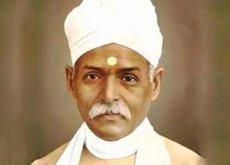
MISLEADING ADVERTISEMENTS- FACTS AND CHALLENGES
PERIPHERAL PHARMACOVIGILANCE CENTRE
FACULTY OF AYURVEDA
BANARAS HINDU UNIVERSITY

Slide 2
MISLEADING ADVERTISEMENTS
Are herbal remedies safe and carry no side effects ?

Slide 3
MISLEADING ADVERTISEMENTS
Minister of AYUSH Shri Sarbananda Sonowal in a written reply in Lok Sabha on 17/12/2021
State/UTs appointed officers can inspect and take necessary action for MLA
On the basis of
Drugs and Cosmetics Act, 1940
Drugs and Cosmetics Rule, 1945
Drugs and Magic Remedies (Objectionable Advertisements) Act, 1954
As per the complaints registered in the respective portals
GAMA portal
ASCI
Central Sector Scheme

Slide 4
AYUSH Medicines/Products
Complaints
2015 APRIL 2018 MARCH
809 COMPLAINTS
Herbal medicines
Ministry of Consumer Affairs
DoCA (Department of Consumer Affairs)
Food and Public Distribution
Nodal Officer from Ministry of AYUSH
GAMA Portal (Grievances against Misleading Advertisements)

Slide 5
AYUSH medicines/Products
Complaints
20/01/2017 19/01/2018
732 COMPLAINTS
Herbal medicines
Ministry of AYUSH signed MoU
Advertising Standards Council of India (ASCI)

Slide 6
AYUSH medicines/Products
Complaints
2017 2020
573 COMPLAINTS
Herbal medicines
Six states/UTs including Delhi, Maharashtra, Gujarat, Kerala, Karnataka and Chandigarh have reported 573 instances of such misleading advertisement during the last three years.

Slide 7
MISLEADING ADVERTISEMENTS
Initiated guidelines for Mass media for refraining from MLA
Strict objection to use any Government Institution names in the product promotion

Slide 8
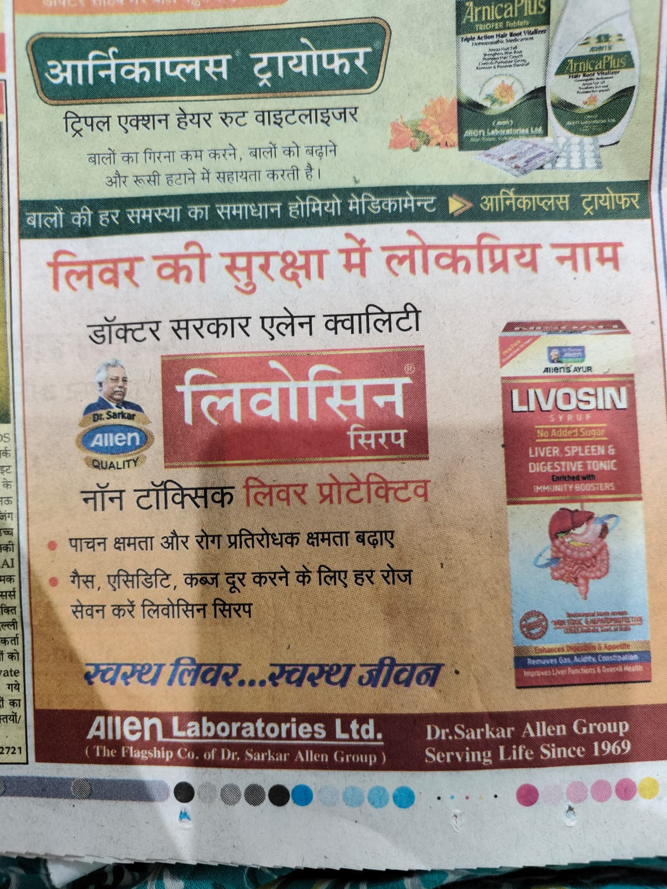
MISLEADING ADVERTISEMENTS
Claims as approved after clinically tested from CCRAS, Kolkata, Government of India

Slide 9
CASE STUDIES

Slide 10
2009 – Kerala Incident- “Musli Power Xtra”
Accused- Peethambaran Kunnathoor, Chennai
Punishment- A penalty of 50, 000/- and imprisonment of 4 months- by the Division bench comprising Justice A.K.Basheer and Justice P.Q. Barkath (Kerala High Court)
Case was raised by- (1) Dr. R Y John, Ayurveda Drug Controller for violating the Section 3 (b), of DMR Act, 1954. (2) Peoples Union for Civil Liberties (PUCL)

Slide 11
What is Sec 3(b), DMR, 1954?
3. Prohibition of advertisement of certain drugs for treatment of certain diseases and disorders
Maintenance or improvement of the capacity of human being for sexual pleasure
The capsules were also adulterated and admixed with 'Tadalafil' in an official study engaged by the authorities
Schedule H drugs= sildenafil and tadalafil
Can cause - Photophobia, dyspepsia and severe hypotension which can lead to coma and even death.
Notes:
Section 3-Prohibition of Advertisement of Certain Drugs for Treatment of Certain Diseases and Disorders.–
Prevent miscarriages, (b) related to sexual pleasure, (c) Schedule Diseases

Slide 12
Divya Pharmacy Incident
Violation of Section 3 of the Drug and Magic Remedies, 1954.
Diabetes
Eye diseases
Thyroid disorders
Obesity
Case filed by Dr K.V. Babu, Ophthalamologist against Divya Pharmacy

Slide 13
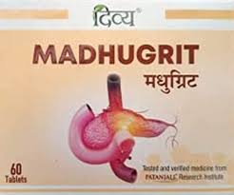
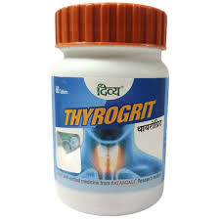
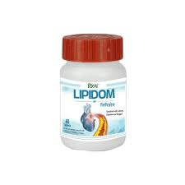
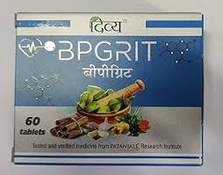

Slide 14
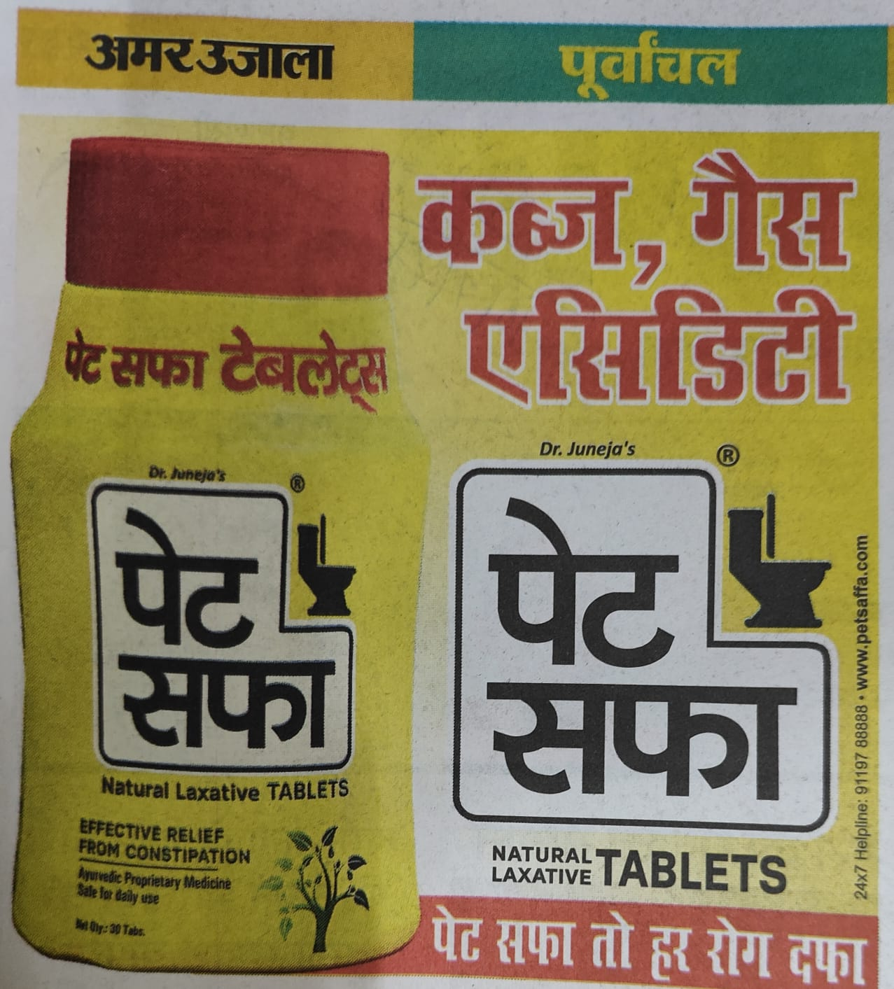
“Safe for daily use”
Sec 4 (a) DMR Act, 1954
Sec 47 Consumer Protection Act, 2019.
Sec 47 Consumer Protection Act, 2019.
Violation of Sec 3(d), DMR Act 1954

Slide 15
What is Sec 4, DMR, 1954?
Section 4 -Prohibition of misleading advertisements relating to drugs.—
Subject to the provisions of this Act, no person shall take any part in the publication of any advertisement relating to a drug if the advertisement contains any matter which—
(a)directly or indirectly gives a false impression regarding the true character of the drug; or
(b)makes a false claim for the drug; or
(c)is otherwise false or misleading in any material particular.

Slide 16
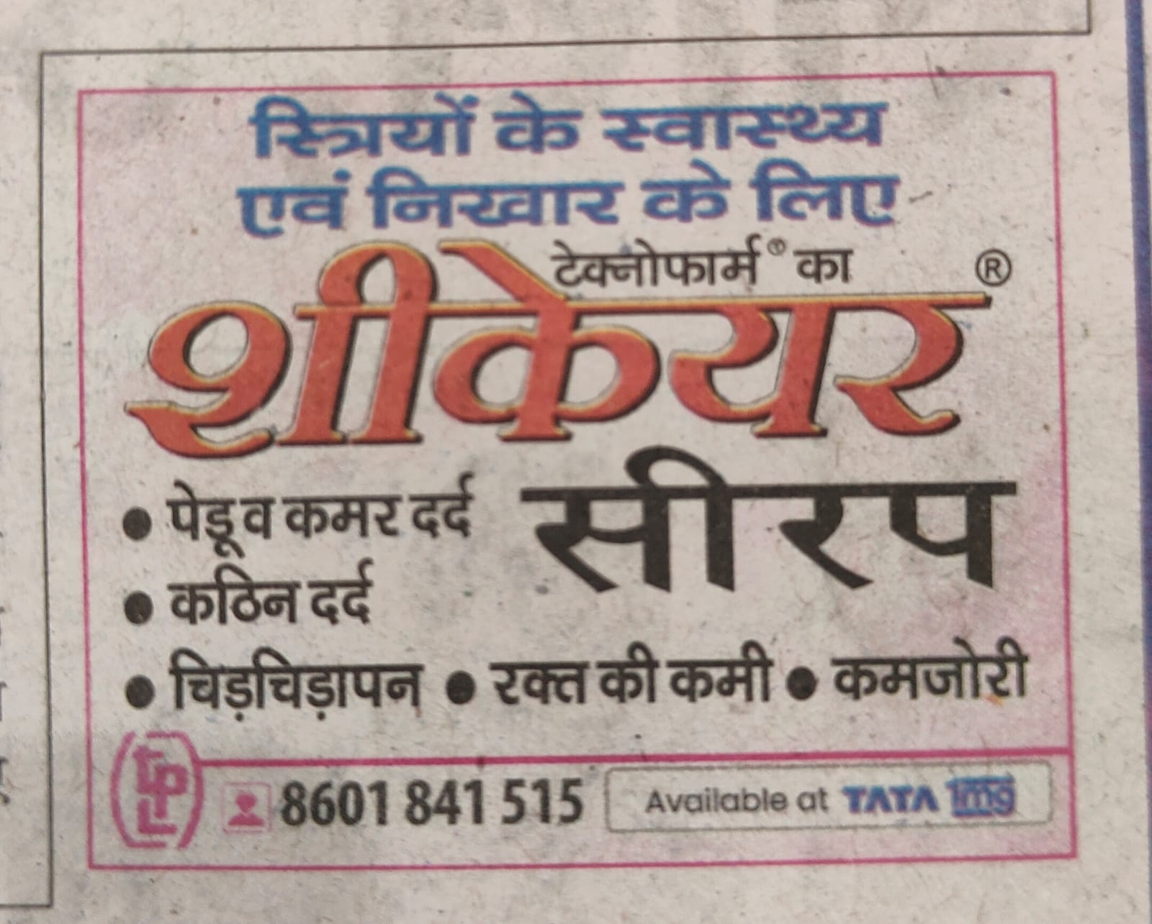
In the Schedule of Diseases-
“Female diseases in general”
Violation of Sec 3(d), DMR Act 1954

Slide 17
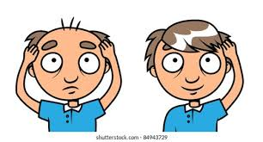
Hair fall
Premature greying
Schedule Diseases
Growth of new hair
Anti-aging
??????? Clinically tested !!!!!

Slide 18
Advertisement Banned Diseases
1.AIDS 2. Angina pectoris 3. Appenditis
4. Arteriosclerosis 5. Blindness 6.Blood poisoning
7. Bronchial asthma 8. Cancer 9. Benign Tumour
10. Cataract 11. Change in color and growth of new hair
12. Change of fetal sex by drugs 13. Congenital malformations
14. Deafness 15. Diabetes
16. Diseases and disorders of the uterus
17. Epileptic fits and Psychiatric disorders
18. Encephalitis 19. Fairness of the skin 20. Form and structure of the breast
21. Gangrene 22.Genetic disorders 23. Glaucoma
24. Goitre 25. Hernia 26.High/Low B.P
27. Hydrocele 28. Insanity
29. Increases brain capacity and improves memory.
30. Improvement of height of children and adults
31. Improvement of shape and size of sexual organ and in duration of sexual organ
32.Improvement in the strength of natural teeth
33. Improvement in vision 34. Jaundice/Hepatitis/Liver Disorders
35.Leukaemia 36. Leucoderma

Slide 19
Advertisement Banned Diseases
37.Maintanence or improvement of sexual pleasure
38. Mental retardation, sub-normalities and growth
39.Myocardial infarction 40. Obesity 41. Paralysis
42.Parkinsonism 43. Piles and Fistulae 44. Power to rejuvenate
45. Premature greying 46. Rheumatic heart disease
47. Premature ageing 48. Heart disease
49.Sexual impotence, premature ejaculation & Spermatorrhoea
50.Spondylitis 51. Stammering 52. Stones in gall bladder, kidney, bladder
53. Varicose vein 54. Bright’s disease 55. Disease and disorders of brain
56. Disorders of menstrual flow 57. Disorders of the prostatic gland 58. Dropsy
59. Female diseases in general 60. Hysteria 61.Infantile paralysis
62. Leprosy 63. Lock jaw 64. Locomotor ataxia
65. Lupus 66. Plague 67. Pleurisy

Slide 20
Advertisement Banned Diseases
68. Pneumonia 69. Rheumatism 70. Ruptures
71. Small pox 72. Sterility in women 73. Trachoma
74. Tuberculosis 75. Typhoid fever
76. Ulcers of gastro-intestinal tract
77. Venereal diseases
78. Pyorrhea and sensitive teeth
Diseases and Ailments (by whatever Name described) which a Drug may not Purport to Prevent or Cure or Make Claims to Prevent or Cure

Slide 21
Amendment of the Schedule, DMR Act, 1954
1. With the amendment there is now a total of 78 medical conditions specified for which no cure can be claimed and advertised for the same reason.
2. These new additions also specify the incurable conditions mentioned in the Schedule J, Drug and Cosmetic Rule, 1945.
Applicability of Section 3(d) and 14.
These ads can be sent confidentially to a Reg. Medical practitioner, can be kept in the premises of such a practitioner and also can be mentioned in the medical journals. (Section 14 and Section 16 of DMR, 1954)
Notes:
Before it was 54 and now its 78.

Slide 22
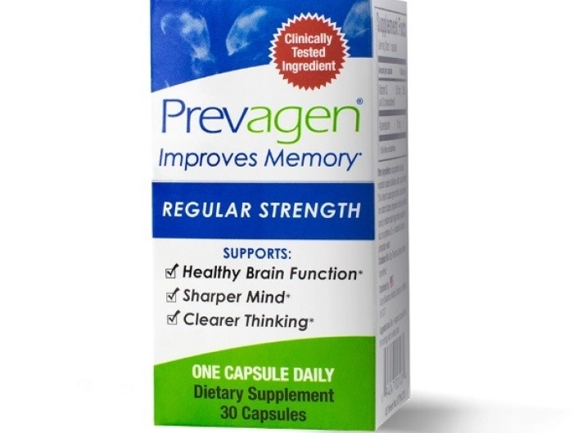

Slide 23
Punishment
First conviction –imprisonment up to 6 months or fine or both
In the case of a subsequent conviction----imprisonment which may extend to one year (12 months), or with fine, or with both.
Conjoined with the CONSUMER PROTECTION ACT- 2 Years and on Subsequent offense punishment up to 5 years and fine of 10 lakh and even up to 50 Lakh

Slide 24
DMR Act, 1954 – Officer Examination
Under section 8 (1) of the Drugs and Magic Remedies (Objectionable Advertisements) Act, 1954
State Governments have been directed for appointing Gazette Officers
Search any premises or examine or seize any record which contravenes any provisions of the Act
About 621 Gazette Officers for this purpose are reported to have been appointed in 22 states.

Slide 25
RULES AND REGULATIONS IN CONNECTION WITH DMR, 1954.

Slide 26
Consumer Protection Act, 2019
Chapter 3, section 21
Where the Central Authority is satisfied after investigation that any advertisement is false or misleading and is prejudicial to the interest of any consumer or is in contravention of consumer
Punishment for misleading advertisement- chp-7
Punishment for false or misleading advertisement.—Any manufacturer or service provider who causes a false or misleading advertisement to be made which is prejudicial to the interest of consumers shall be punished with imprisonment for a term which may extend to two years and with fine which may extend to ten lakh rupees; and for every subsequent offence, be punished with imprisonment for a term which may extend to five years and with fine which may extend to fifty lakh rupees.

Slide 27
Cable Television Network Rules
Section 7- Advertising Codes:-
Subsection 5-
No advertisement shall contain references which are likely to lead the public to infer that the product advertised or any of its ingredients has some special or miraculous or super-natural property or quality, which is difficult of being proved.
.

Slide 28
Infant Milk Substitutes
“Infant food’ means : any food (by whatever name called) being marketed or otherwise represented as a complement to mother's milk to meet the growing nutritional needs of the infant after the age of four months.
To be labelled as such
PFA-
Prevention of Food Adulteration Act, 1954
IMPORTANT NOTICE
“MOTHER’S MILK IS BEST FOR YOUR BABY” (capital letters)
To be used on the advise of a health worker
This is not the sole source of nutrition
Instruction for preparations and hazards for not following it.
Ingredients used
Storage conditions
Batch number, D.O.P and D.O.E
Should promote breast feeding under all circumstances.
CONTAINER
BIS- Sec.3 of Bureau of Indian Standards Act, 1986

Slide 29
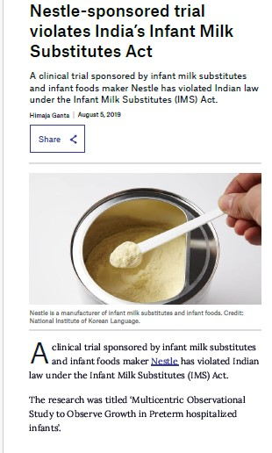
*Violation of IMS Act, 1992 by Nestle in 2019 by sponsoring milk substitute trials in preterm babies of 5 hospitals namely-
Cloud nine Hospital in Bangalore
Institute of Child Health in Kolkata
Manipal Hospital in Bangalore
Sir Ganga Ram Hospital in New Delhi
Calcutta Medical Research Institute in Kolkata.
BPNI (Breast Feeding Promotion Network of India)
ICMR (Indian Council of Medical research)
Violation Sec- 9.2 of IMS Act

Slide 31
Rule 158-B, Drug & Cosmetic Rules, 1945
In 1945, the mentioned rule provides the guidelines for pilot studies which will generate proof of safety and effectiveness for grant of license to manufacture for sale certain categories of Ayurveda, Siddha and Unani drugs.

Slide 32
DISCUSSION
The “Expectation of safety and with no side effects “ exists with herbal remedies.
The self medication provisions are to be discouraged with sensitization programs.
Patients are to be encouraged to follow strict pathya to receive all the benefits of any Ayurvedic dosage form.
Any products carrying “Ayurveda” should be strictly recommended to be used with instructions from a Reg. Medical Practitioner.
Stringent GMP certified practices of pharmacies should be made mandatory.
Vigilance over the OTC products have to be more enhanced.

Slide 33
CONCLUSION
Strict control over OTC products.
Strict prescription wise dissemination for Rasoushadhi.
`Compulsory Sensitization campaigns and Awareness classes to spread the information.
The culture of reporting Misleading Advertisements (MLA) have to be encouraged same as the ADRs reporting are propagated.

Slide 34
HOW TO REPORT A MISLEADING ADVERTISEMENT?

Slide 36
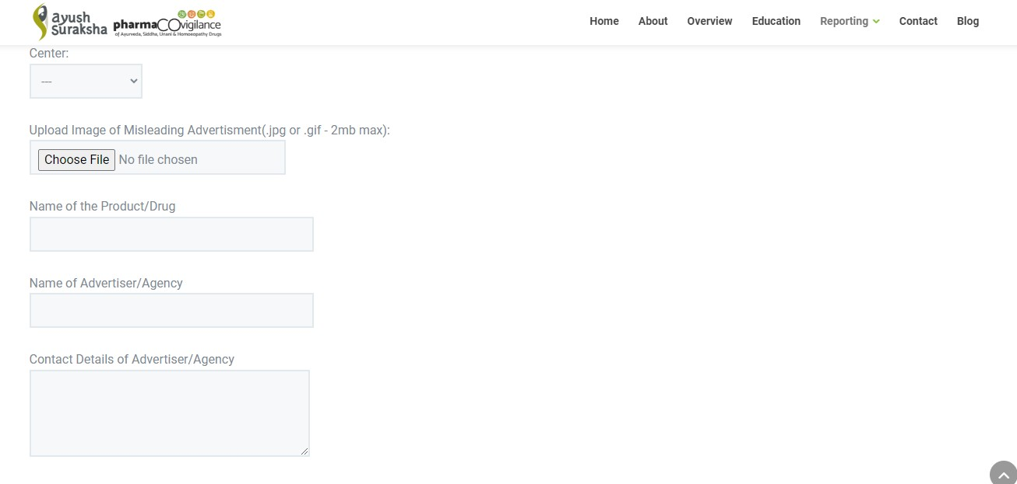

Slide 37
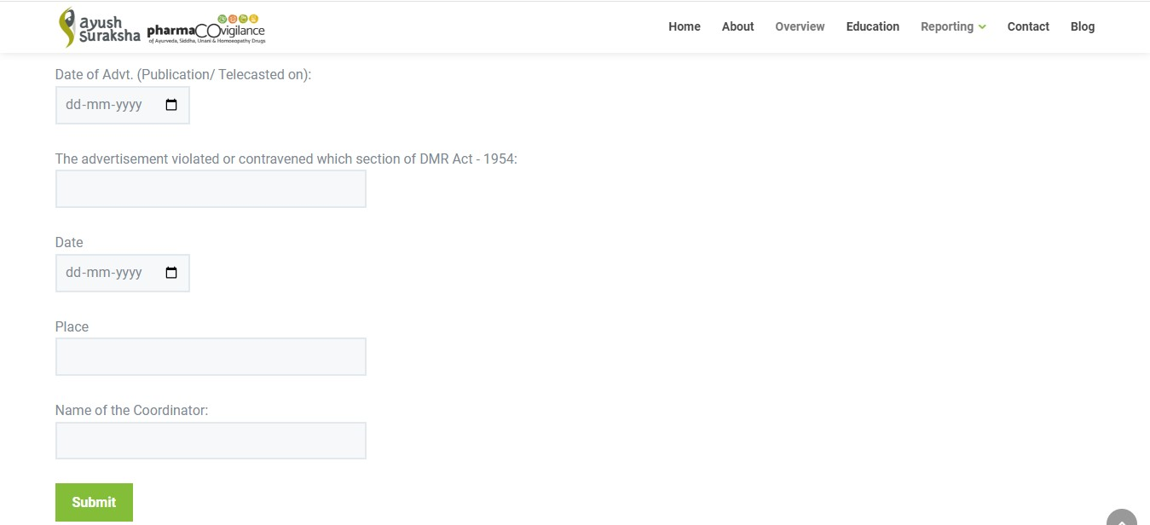

Slide 38
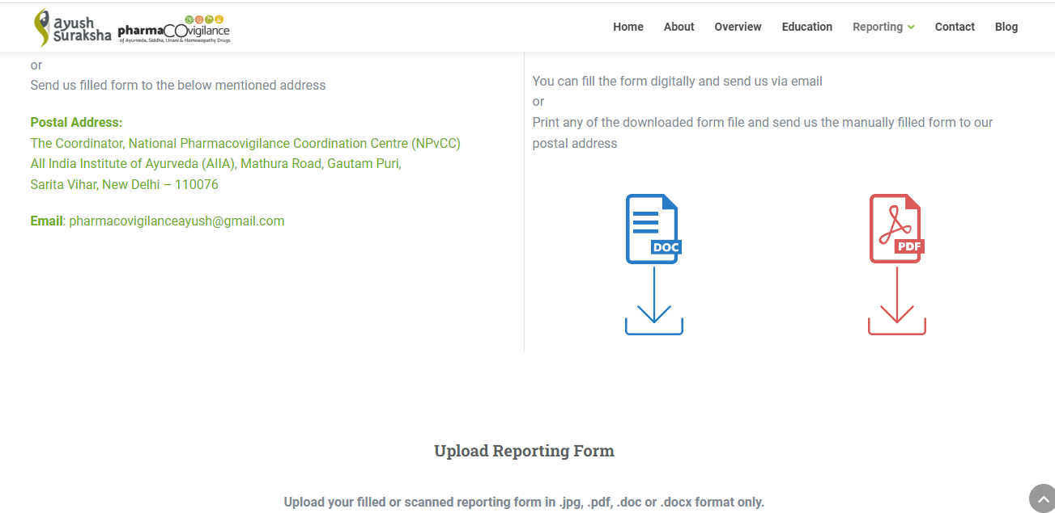

Slide 39
Thankyou

